Slide 1
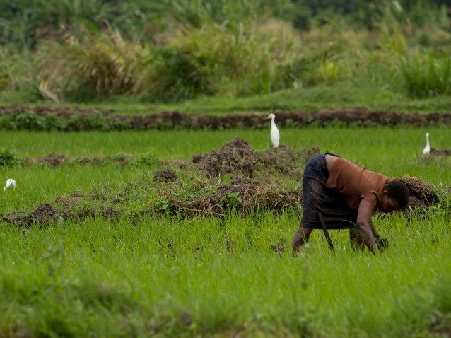
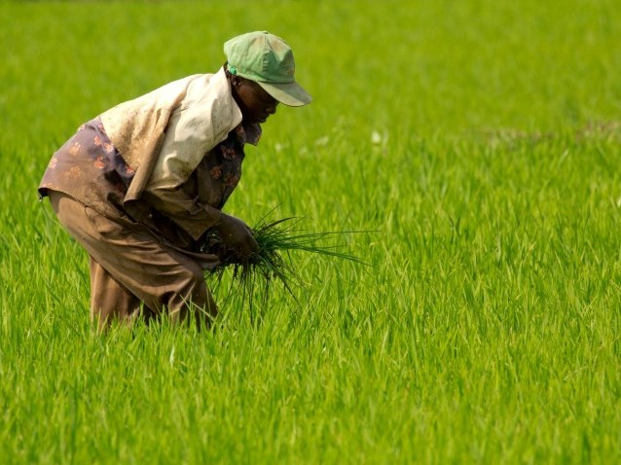
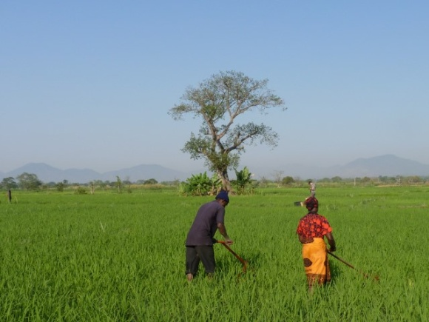
Weed species and management
Training Course for Service Providers & Agricultural Extension Agents
AfricaRice
2017

Slide 2
Program (1)
Weed species and Management
Impact of weeds on rice
Important weeds of rice
Video 1: Explaining weed categories
Weed management
Video 2: Weed Management
Herbicides
Video 3: Safe and Correct Use of Herbicides
Rotary weeders
Video 4: Using the Rotary Weeder in Lowland Rice
Striga management
Video 5: Striga Management

Slide 3
Program (2)
2a. RiceAdvice-WeedManager
Step 1: downloading & installing
Step 2: creating farmer profile
Step 3: characterizing farm conditions & weed problems
Step 4: generating advices
Step 5: selecting final recommendations
Step 6: sending data & troubleshooting
2b. RiceAdvice-WeedManager – technical advices
3. Protocol for 2017
Selecting farmers
Demarcation of test plots and observation areas
Generating recommendations
Monitoring/guiding farmers during season
Weed & yield assessments & farmer feed back surveys

Slide 4
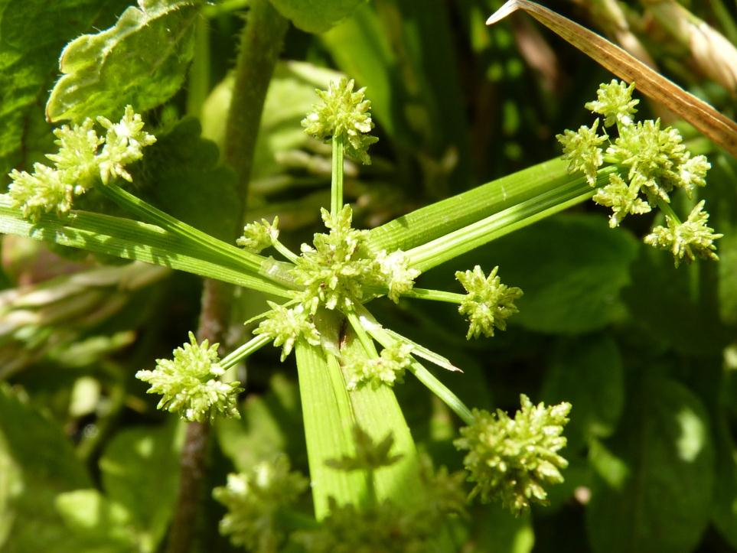
Impacts of weeds on rice
– direct and indirect impacts –

Slide 5
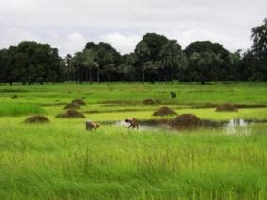
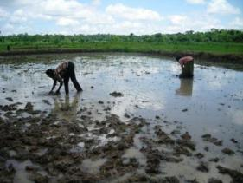
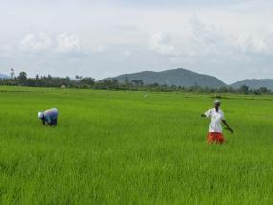
Impact of weeds on rice
Major constraint across systems and regions
Economic annual loss SSA: $1.5 billion
Direct impacts: yield loss despite control 15-23% due to:
General weeds: competition for nutrients, water, light
Parasitic weeds: extracting host metabolites, water, nutrients and exerting phytotoxic effects on host

Slide 6
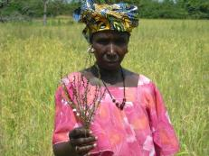
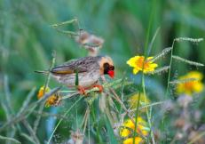
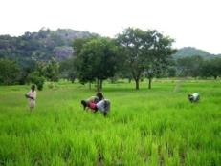
Impact of weeds on rice
Indirect impacts:
  Grain quality
  Lower water productivity
  Losses due to improper herbicide use
  Break on new systems - e.g. labor-, water-saving -
  Socio-economic: off-farm activities & schooling rates
  Health/energy: Hand- weeding 1 ha-> walking 10 km in bended position …
  Vectors for insects, diseases, rodents and … birds

Slide 7
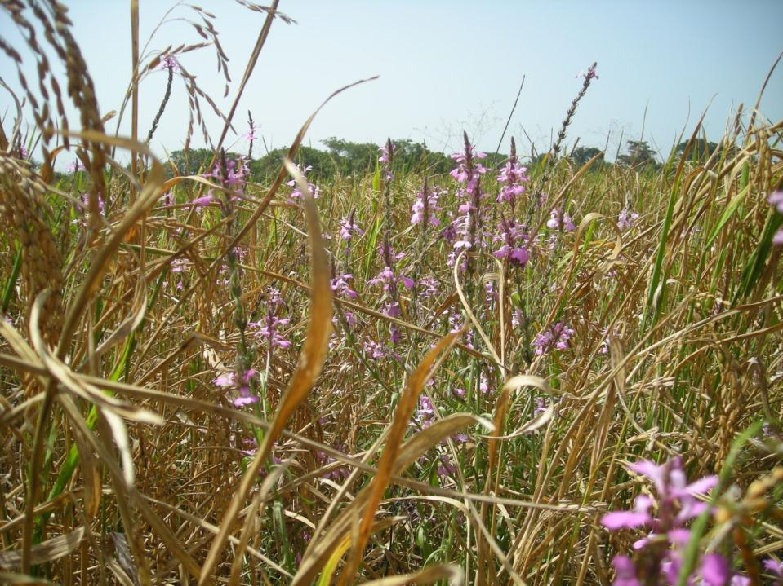
Important weeds of rice
– types, traits, species –

Slide 8
Weed Management — Video 1
Explaining Weed Categories

Slide 9
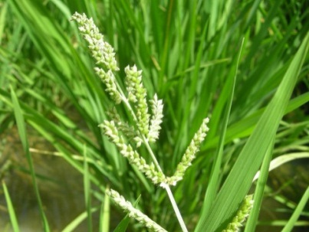
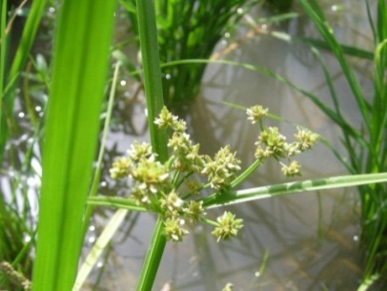
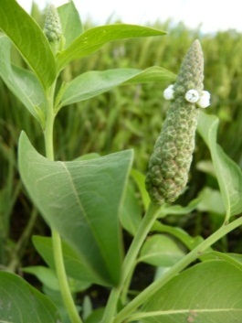
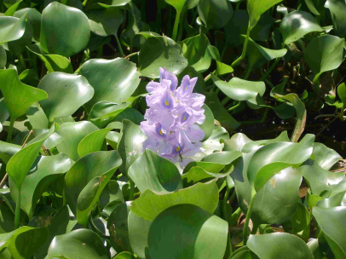
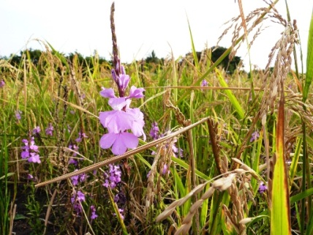
Types of weeds
Grasses (Poaceae, formerly: Gramineae)
Sedges (Cyperaceae)
Broad-leaved weeds
Aquatic weeds
Parasitic weeds

Slide 10
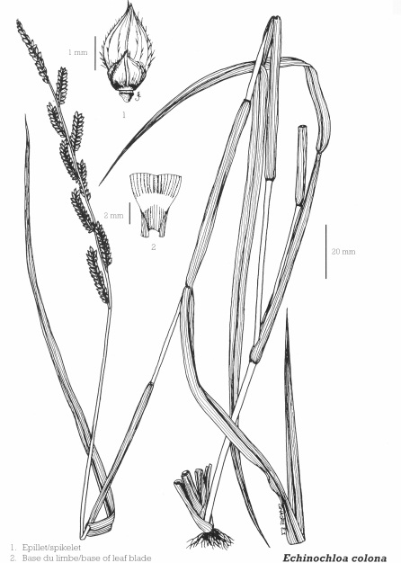
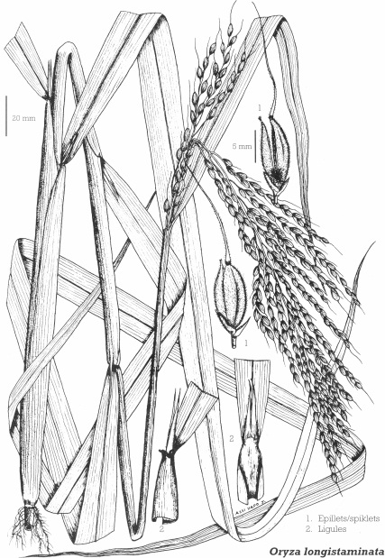
Types of weeds
Grasses (Poaceae, formerly: Gramineae):
  Look like rice (in early stages)
  Long thin leaves with one central vein
  Round, hollow stems …
  … composed of segments separated by nodes
  Fibrous root system lacking a principal root
  Common and notorious grasses:
    Echinochloa colona (drawing)
    Oryza longistaminata (drawing)
    Ischaemum rugosum
    Leersia hexandra

Slide 11
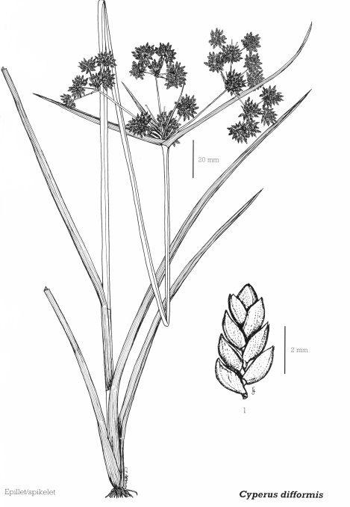
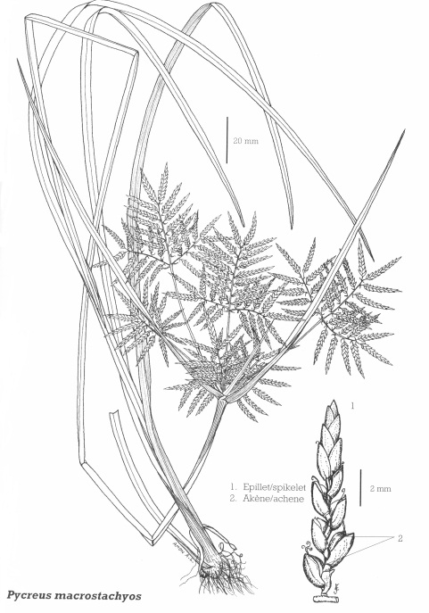
Types of weeds
Sedges (Cyperaceae):
  Look like grasses
  Long thin leaves with one central vein, but …
  Solid smooth stems …
  … triangular, polygonal, round in cross-section …
  … no nodes!
  Common and notorious sedges:
    Cyperus difformis (drawing)
    Pycreus macrostachyos (drawing)
    Cyperus iria, C. haspan, C. rotundus
    Kyllinga pumila

Slide 12
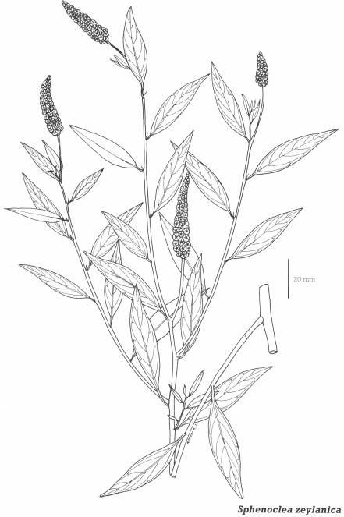
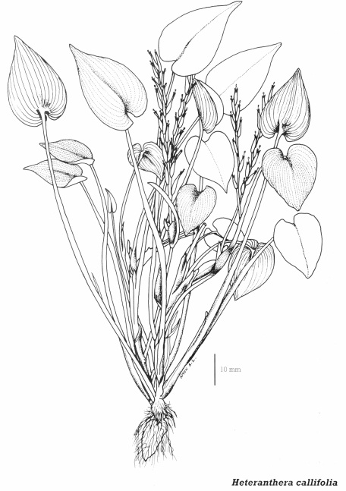
Types of weeds
Broad-leaved weeds:
  Clearly different from grasses and sedges
  Broader leaves with branched veins
  First leaves form a pair
  One principal root developing into tap root
  Common and notorious broad leaved weeds:
    Sphenoclea zeylanica (drawing)
    Heteranthera callifolia (drawing)
    Ludwigia abyssinica
    Ipomoea aquatic

Slide 13
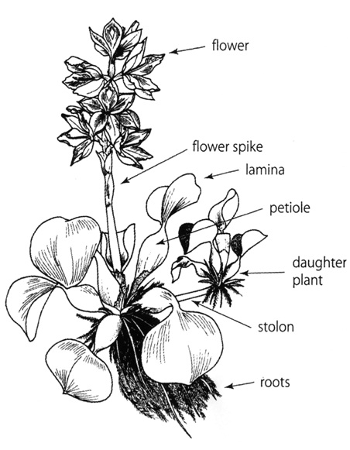
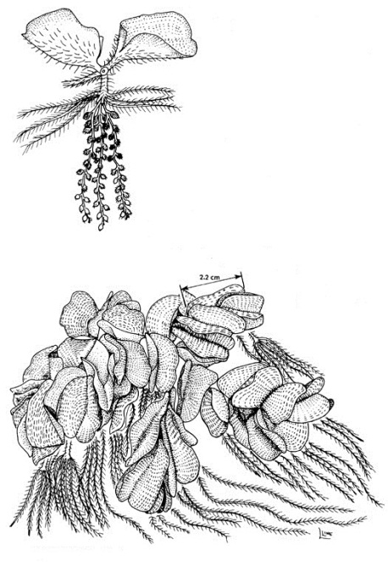
Types of weeds
4. Aquatic weeds:
  Living in or on the water
  Free-floating
  Fern like … mostly vegetative reproduction
  … using rhizomes, stolons … daughter plants
  Common and notorious aquatic weeds:
    Eichhornia crassipes (drawing)
    Salvinia molesta (drawing)
    Lemna spp.
    Pistia stratiotes

Slide 14
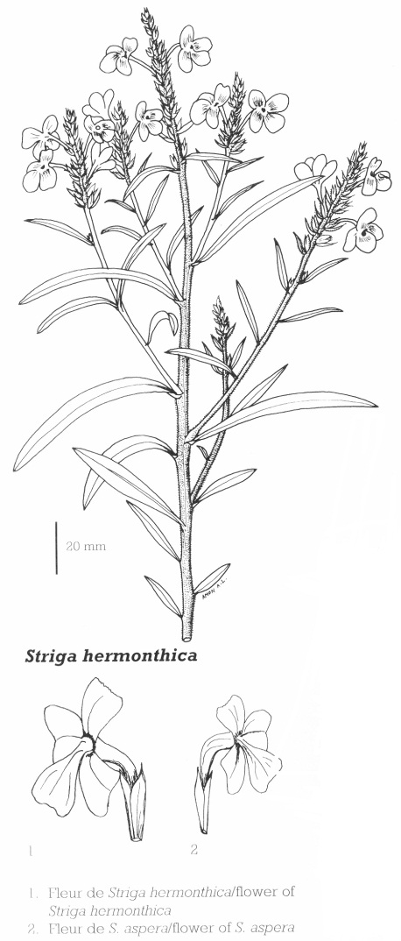
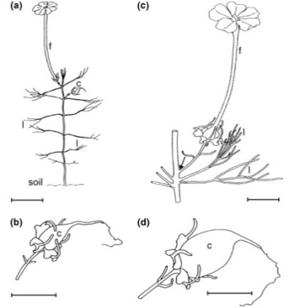
Types of weeds
5. Parasitic weeds:
  Parasitize on host (rice) roots
  Erect, slender plants with slender leaves
  Striga spp.: rough stems and leaves…
  … attractive purple, pink or orange flowers
  Rhamphicarpa: smooth stem, needle-like leaves
  … white flowers with long corolla … open at night
  Common and notorious parasitic weeds:
    Rhamphicarpa fistulosa (drawing)
    Striga hermonthica (drawing)
    Striga asiatica, S. aspera

Slide 15
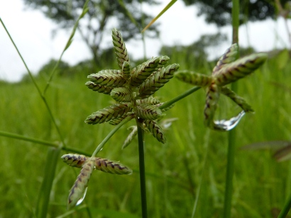
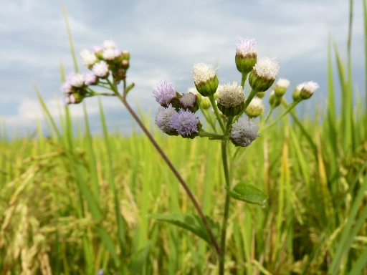
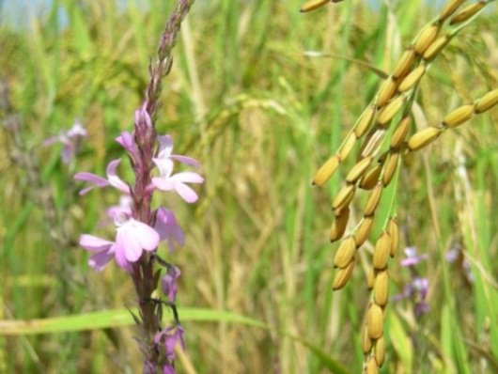
Types of weeds
Other categorizations:
  Ecology: Upland, Lowland, Hydromorphic
  Life-cycle: Annual, Bi-annual, Perennial
Q1. Why is it important to understand the ecology and biology of weeds?
A1. For targeted control strategies
Q2. What are important traits of weeds with respect to weed management?
A2. Propagation strategies (e.g. seed or underground structures), weed category (grass. Sedge, broadleaved, parasitic, aquatic), life-cycle (e.g. annual, bi-annual, perennial), preferred environment ….

Slide 16
Ecology & biology of weeds
Life cycle: annual, bi-annual, perennial, parasitic
Reproduction: sexual (seeds), a-sexual (vegetative)

Slide 17
Ecology & biology of weeds
Life cycle: annual, bi-annual, perennial, parasitic
Reproduction: sexual (seeds), a-sexual (vegetative)
Seeds: germination requirements
Vegetative structures: rhizomes, stolons, creeping roots/stems, tubers, bulbs → Extremely difficult to control; breaking/cutting = multiplication
Ecology: environmental adaptation & tolerances determine distribution & persistence
Examples of germination requirements:
Obligate parasitic weeds (Striga spp.) require host root exudates
Half of the annual weed species require light

Slide 18
Important weed species
Upland |  | Hydromorphic |  | Lowland
Rottboellia cochinchinensis | A, g | Ageratum conyzoides | A, b | Sphenoclea zeylanica | A, b
Digitaria horizontalis | A, g | Panicum laxum | A, g | Cyperus difformis | A, s
Ageratum conyzoides | A, b | Leersia hexandra | P, g | Fimbristylis littoralis | A, s
Euphorbia heterophylla | A, b | Cyperus rotundus | P, s | Oryza longistaminata | P, g
Imperata cylindrica | P, g | Digitaria horizontalis | A, g | Echinochloa colona | A, g
Paspalum scrobiculatum | P, g | Eclipta prostrata | A, b | Echinochloa crus-pavonis | A, s
Mariscus cylindristachyus | P, s | Spilanthes uliginosa | A, b | Leersia hexandra | P, g
Trianthema portulacastrum | A, b | Commelina benghalensis | A, b | Oryza barthii | A, g
Striga hermonthica | A, b¹ | Fimbristylis littoralis | A, s | Cyperus iria | A, s
Striga asiatica | A, b¹ | Echinochloa colona | A, g | Bolboschoenus maritimus | P, s
Cynodon dactylon | P, s | Cyperus esculentus | P, s | Ischaemum rugosum | A, g
Commelina benghalensis | A, b | Cynodon dactylon | P, g | Panicum laxum | A, g
Brachiaria lata | A, g | Rhamphicarpa fistulosa | A, b² | Ludwigia abyssinica | A, b
Cyperus rotundus | P, s |  |  | Ammania prieureana | A, b
Chromolaena odorata | P, b |  |  | Cyperus esculentus | P, s
Panicum laxum | A, g |  |  | Cyperus halpan | P, s
 |  |  |  | Eclipta prostrata | A, b
 |  |  |  | Rhynchospora corymbosa | P, s
Adapted from: Rodenburg and Johnson (2009); ¹ obligate hemi-parasitic, ² facultative hemi-parasitic; A= annual, P= perennial; g = grass, b = broadleaved, s = sedge

Slide 19
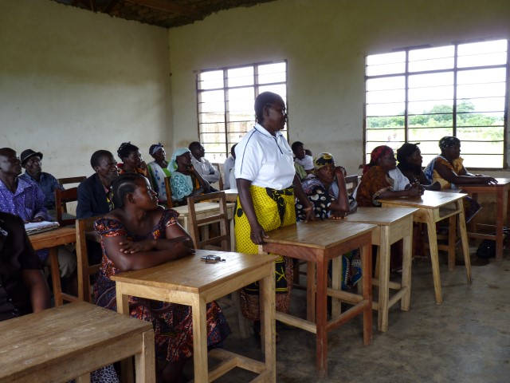
Questions & Answers
Can you name different weed categories?
Why is it important to understand the ecology and biology of weeds?
What are important traits of weeds with respect to weed management?
Can you name some noxious weeds? (grasses – sedges – broad leaved – parasitic – aquatic)
Is there anything you would like me to explain further?

Slide 20
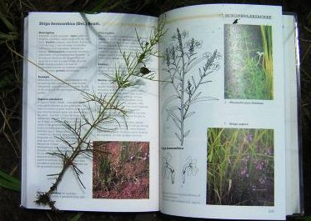
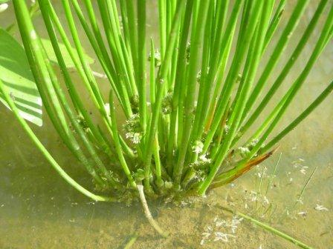
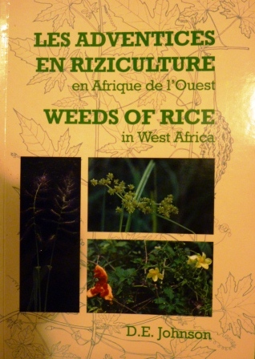
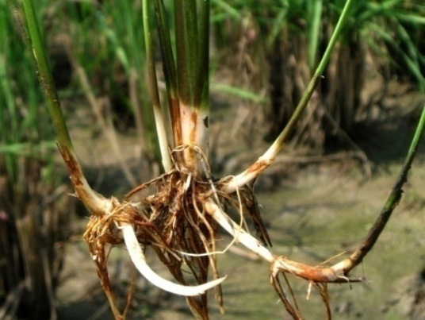
Weed identification
Purpose?
  “Know your enemy”
Using a guide, e.g.:

Slide 21
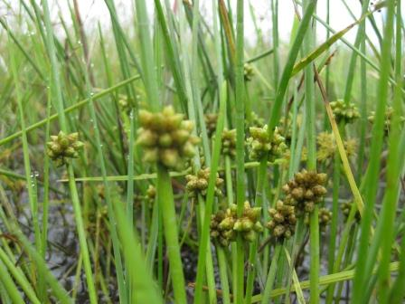
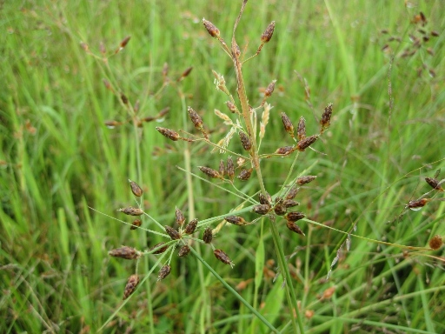
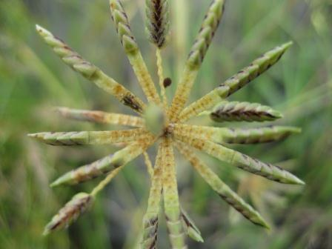
Weed identification
Look for eye-catching features
  e.g. inflorescence, leave shape, hairiness
If species cannot be identified in the field:
  take good pictures,
  make a herbarium sample and identify later…
Make sure all essential information is noted:
  location, ecology, conditions on the spot like water and soil, name of collector(s)

Slide 22
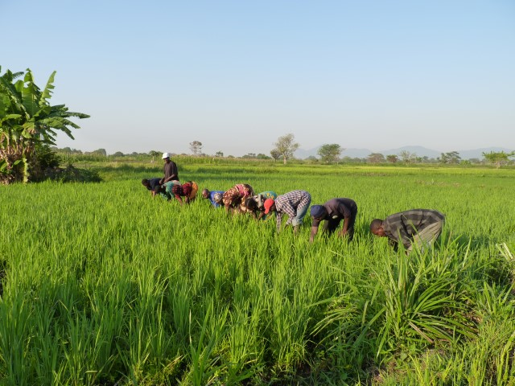
Weed Management
- Principles, Technologies, Strategies -

Slide 23
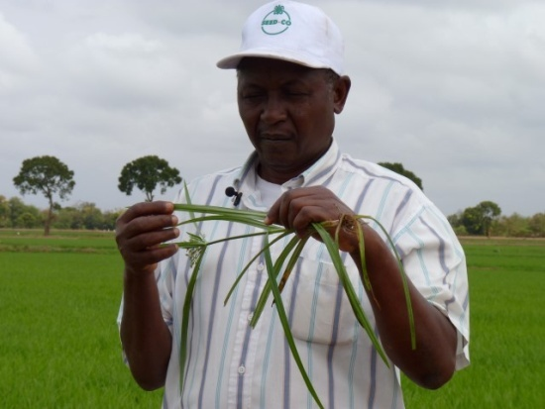
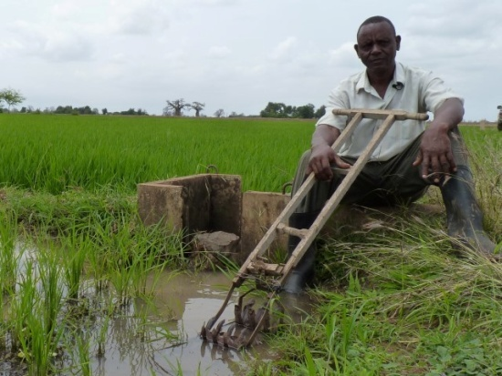
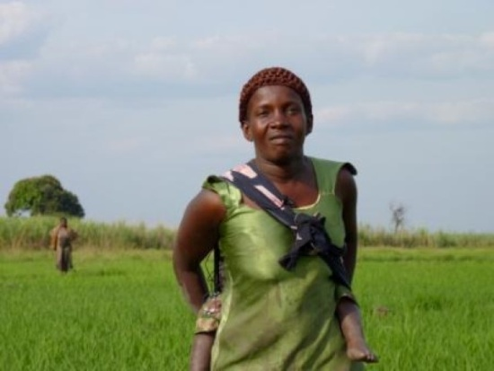
Weed Management
Preconditions:
  Weed species identification
  Agro-ecosystem characterization
  Farm characterization
Why?
  The species, ecosystem and resource availability determine which weed management strategies can be applied

Slide 24
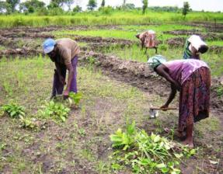
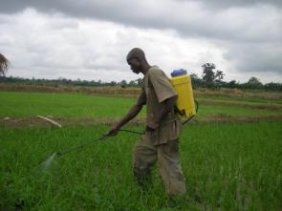
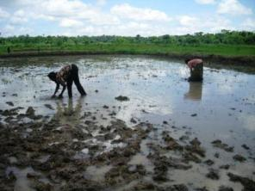
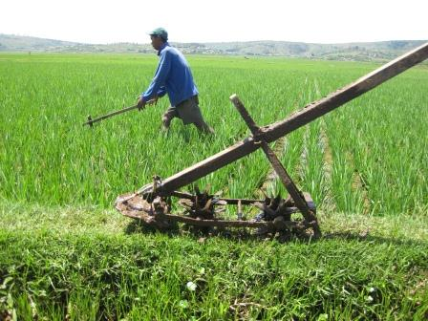
Weed Management
Which weed management options do you know?
Strategies (1):
  Mechanical – e.g. hand, hoe, rotary weeder
  Chemical – herbicides
  Biological – e.g. fungal, insects, bio-herbicides
  Cultural – e.g. flooding, rotations/intercropping, establishment methods, mulching
  Varietal – weed competitiveness, resistance & tolerance against parasitic weeds
  Integrated – combination of the above

Slide 25
Weed Management
Strategies (2):
  Irrigated lowland – e.g. flooding, GAP, row transplanting, rotary weeder, pre- and post-emergence herbicides, crop rotations
  Rainfed lowland – e.g. GAP, post-emergence herbicides, row transplanting, bunding, leveling, rotary weeder
  Rainfed upland – e.g. GAP, crop rotations, intercropping, mulching, competitive/resistant varieties, push weeder, post-emergence herbicides
Strategies (3):
  Preventive – Avoiding weed infestations or re-growth
  Curative – Treating weed infestations

Slide 26
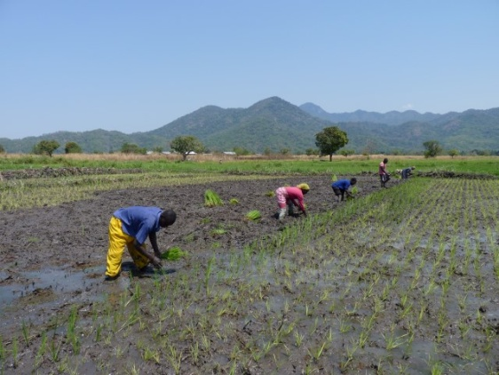
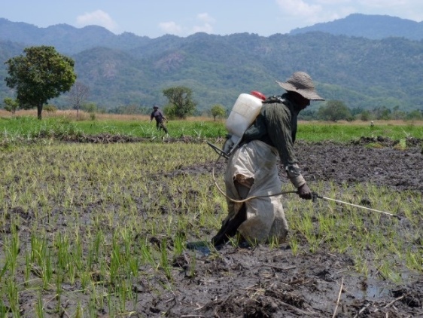
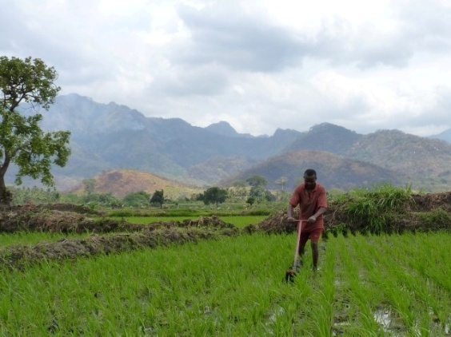
Weed Management
Examples of preventive measures
  GAP, incl. transplanting, leveling, bunding
  Flooding
  Mulching
  Weed competitive cultivars
  Pre-emergence herbicides
  Flushing irrigation channels before use
  Post- and pre-season tillage to kill vegetative structures
Examples of curative measures
  Post-emergence herbicides
  Hand weeding
  Hoe / rotary weeding
  …
Do you know examples of preventive weed management practices?
Do you know examples of curative weed management practices?

Slide 27
Some weed management examples developed and tested by AfricaRice and partners

Slide 28
Striga resistant rice varieties
Genetic variation in resistance against the two main Striga species identified
Most resistant cultivars: NERICA-1, -2, -5, and -10 for S. asiatica and NERICA-2-5, 10, 13 and -17 for S. hermonthica
IR49255-B-B-5-2: superior Striga hermonthica resistance

Slide 29
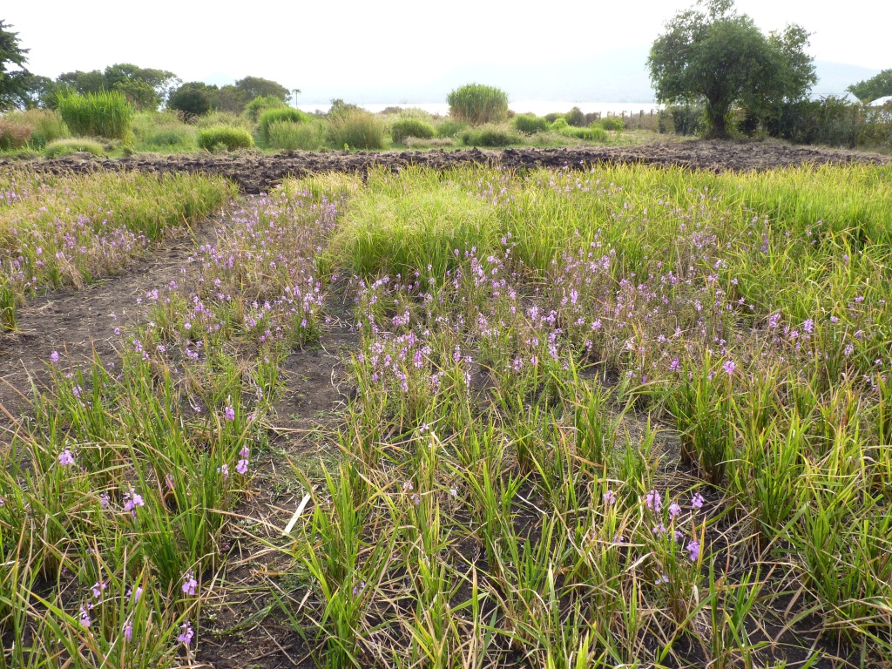
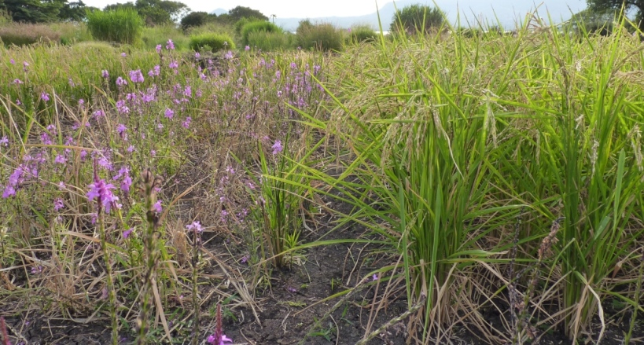
Super India
IAC165
WAB181-18
WAB56-50
IR49255-B-B-5-2
NERICA-10
NERICA-6
NERICA-8
NERICA-9
NERICA-1
NERICA-5
NERICA-3

Slide 30
Weed competitive lowland rice varieties
TOG5681 most weed suppressive
NERICA-L-6, -32, -35, -37, -42, -53, -55, -58 and 60: superior weed-free and weedy yields
Interspecific breeding: O. glaberrima improves yield and weed competitiveness of O. sativa: Jaya good future candidate
Long crop duration benefits weed competitiveness
Condition | Variety group | Grain yield (g m⁻²)
 |  | Year 1 |  | Year 2
Weed-free | NERICA-23, -25, -47, CG14, TOG5681 | 301 | b | 394 | c
 | NERICA-6, -32, -35, -37, -42, -53, -55, -58, -60, Jaya | 596 | a | 648 | a
 | 48 other lowland NERICAs and IR64 | 548 | a | 521 | b
Weedy | NERICA-23, -25, -47, CG14, TOG5681 | 170 | c | 359 | c
 | NERICA-6, -32, -35, -37, -42, -53, -55, -58, -60, Jaya | 416 | a | 601 | a
 | 48 other lowland NERICAs and IR64 | 326 | b | 477 | b

Slide 31
Legume species for weed-suppressive fallow rotations or intercrops
Species | Env. | Spatial and temporal arrangement | Characteristics and traits
Aeschynomene afraspera | RFL | Off season fallow | Biomass accumulation
Aeschynomene histrix | RUL | Relay seeding or off season fallow, burning of residues | N accumulation, Forage, Striga control
Cajanus cajan | RUL | Off season fallow, burning or mulching of residues | N accumulation
Canavalia ensiformis | RUL | Off season fallow | N accumulation, Forage
Cassia occidentalis | RUL | 1 year fallow | Rhamphicarpa ,Striga control
Crotalaria anagyroides | RUL | Off season fallow
Crotalaria juncea | RFL/RUL | Off season fallow
Crotalaria ochroleuca | RUL | Rotation | Striga control
Mucuna spp. | RUL | Off season fallow | N accumulation
Sesbania rostrata | RFL | Off season fallow | Biomass accumulation
Stylosanthes guianensis | RUL | Relay seeding or off season fallow, burning of residues | N accumulation, Striga control

Slide 32

Weed Management
Which management strategy to use?
  Combinations of preventive and curative
  Reducing /avoiding weed seed bank (incl. vegetative structures of perennials) of the soil
  Integrated approaches
  Targeting specific weed problems
  Adapted to farming- and eco-system, farmer preferences and resource-endowment level
Do you know which weed management strategy to use? What considerations to make?

Slide 33
Weed Management
Weed control method | Env. | Advantage | Main disadvantages
Hand weeding | All | Highly effective, prevents weed seed production | Labour intensive, negatively affecting women and children.
Controlled flooding | IL | Controls most weed species | Requires large amounts of water, good infrastructure and equipment
Pre- or post-season fires | All | Can reduce seed production and soil seed bank | Ineffective for species like C. odorata and I. cylindrica; can cause soil degradation
Mechanical weeding | All | Effective, prevents weed seed production, relatively quick | Requires availability of implements, less effective in controlling weeds in the row
Chemical weed control | All | Effective when applied well, labour-saving | High market dependence, requires equipments and know-how, risk of development of herbicide resistant weeds
Improved rice cultivars (weed competitive or parasite resistant) | All | Effective, cheap and labour-saving | Requires combination with other genetic traits (e.g. grain quality, stress resilience)
Crop rotations, intercropping, improved fallow | RUL/RFL | Provide basis of ecologically balanced, resilient systems | Requires land area; risk of competition with rice crop
Integrated weed management | All | Effective and putatively sustainable | Labour and knowledge intensive

Slide 34
Weed Management – Video 2
Effective Weed Management

Slide 35
Herbicides
What are important considerations for the choice of herbicides?
Ecosystem: upland, lowland (rainfed or irrigated)
Timing: pre-emergence or post-emergence
Target: broad-spectrum or specific (i.e. grasses, sedges or broad-leaved species)
Water management: drainage or irrigation
Equipment: sprayer and protective gear
Application rates: concentrations and application speed
Timing: presence or absence or rice, leaf-stage of weed
Never use it as stand-alone measure, or use it continuously:
  Build up of species not targeted/ changing weed composition
  Development of herbicide tolerant weed ecotypes
What are important considerations for the use of herbicides?

Slide 36
Herbicides
 | Upland | Lowland | Example of products | Target | Known exceptions¹
Post-emergence | 2,4-D amine | 2,4-D amine | Herbazol | B,S | Commelina benghalensis, Euphorbia heterophylla
 | bentazon | bentazon | Basagran | B,S
 | MCPA | MCPA | Herbit | B,S
 |  | molinate | Ordram | G,S,(B) | Ischaemum rugosum
 | propanil | propanil | Stam | G,(B, S) | Oryza barthii, Rottboellia cochinchinensis, C. benghalensis, Eclipta prostrata, Trianthema portulacastrum
 | triclopyr |  | Garlon, | B,S
Pre-/ post-emergence |  | bensulfuron | Londax | B,S
 | butachlor | butachlor | Machete | B,S,G | Leersia hexandra, O. barthii, R. cochinchinensis, C. benghalensis, E. prostrata, T. portulacastrum
 |  | glyphosate | Round-up | B, S, G
 |  | paraquat | Gramoxone | B
 | piperophos | piperophos | Rilof | G,S | Fimbristylis littoralis, Eleusine indica
 |  | quinclorac | Facet | G
 | thiobencarb | thiobencarb | Saturn | B,S,G | L. hexandra, O. barthii, R. cochinchinensis, Ageratum conyzoides, C. benghalensis, E. prostrata
Pre-emergence | fluorodifen | fluorodifen | Preforan | B
 | oxadiazon | oxadiazon | Ronstar | B,S,G | O. barthii, C. benghalensis, Chromolaena odorata, E. prostrata
 | pendimethalin | pendimethalin | Stomp | B,S,G | L. hexandra, O. barthii, C. benghalensis, E. heterophylla
 |  | pretilachlor | Rifit | B,S,G

Slide 37
Weed Management – Video 3
Safe and Correct Use of Herbicides

Slide 38

Questions & Answers
What are difficult weed species/categories to control and why?
What is the (most important )objective of any weed management practice ?
What are important considerations for the choice of weed management strategies?
Why are herbicides not always feasible, and how come they are not always effective?
Is there anything you would like me to explain further?

Slide 39






Rotary weeders
Weeders for different ecosystems: lowland (with floater), upland (without floater)
Different types, shapes and forms: one wheel, two wheels; one-row, two-row, multiple rows etc.
Push-weeder – hand-operated rotary weeder – motorized rotary weeder

Slide 40
Weed Management – Video 4
Using the Rotary Weeder in Lowland Rice

Slide 41


Striga Management
Use of resistant/tolerant rice varieties (e.g. NERICA-2, -4, -5, -10)
Use of fertilizers (in particular Nitrogen and Phosphorus)
Sowing timing: delayed sowing combined with early-maturing varieties (e.g. NERICA)
Remove Striga plants before/during flowering
Crop rotations or intercropping with legumes
S. hermonthica
S. asiatica

Slide 42
Weed Management – Video 5
Striga Management

Slide 43

Thank you very much
The Africa Rice Center (AfricaRice): Center of Excellence for Rice Research
j.rodenburg@cgiar.org

