Slide 1

RiceAdvice WeedManager V1.1.x installation & use
May 2017

Slide 2
Prerequisites !!
Weedmanager requires at least Android version 4.3 Make sure you have an Android device (smartphone or tablet) running Android version 4.3 or up. You can check this in the settings (about phone) of your device
Make sure you can access your email on the device

Slide 3
Create an Account
You ONLY need to ‘Create an Account’ if you currently DO NOT yet have a RiceAdvice (Nutrient Manager) account
If you have used RiceAdvice before, you can use your existing Username and Password to login and use WeedManager. If so, you can SKIP this ‘Create an Account’ section and go straight to the ‘Installing WeedManager’ section

Slide 4
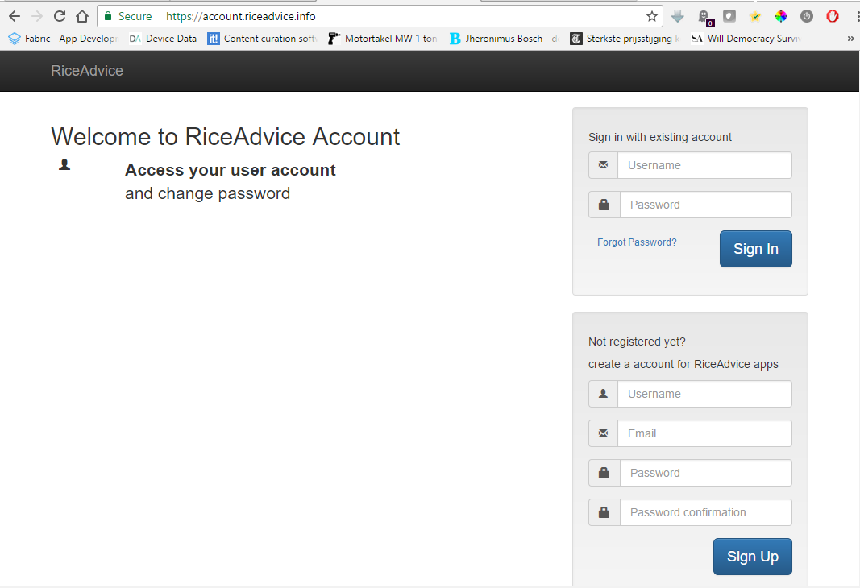
Open your internet browser
Go to https://account.riceadvice.info
Create an account.
Choose a Username, enter your Email, choose a Password and confirm and then click the ‘Sign Up’ button

Slide 5
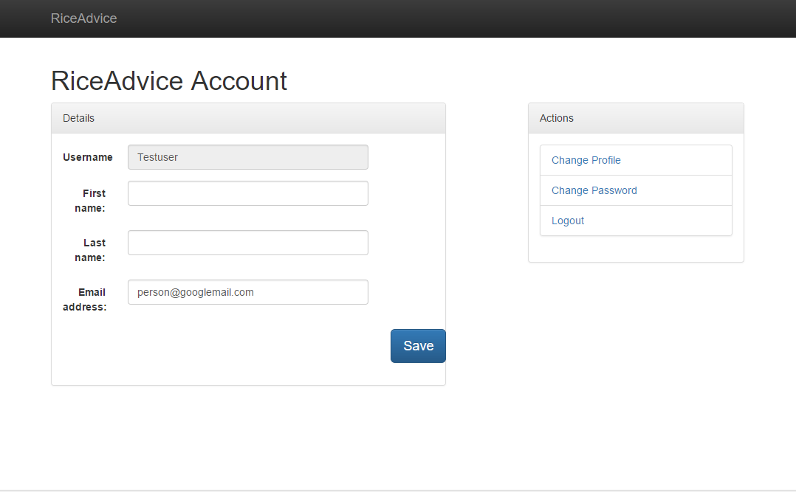
On the next page enter First and Last name
Click the ‘Save’ button
Close your Internet Browser

Slide 6
Installing WeedManager

Slide 7
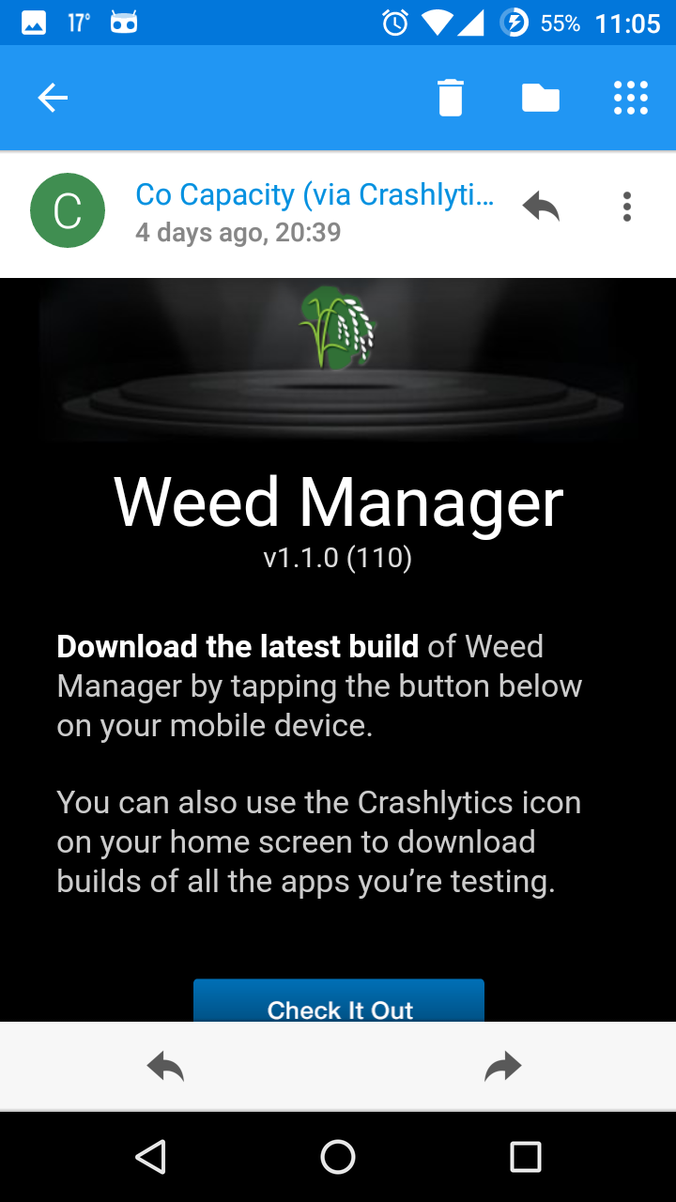
Send an email to support@riceadvice.info from the email account you used in your RiceAdvice profile, requesting for WeedManager download
You will receive an email notification from ‘Crashlytics’ to download and install Weedmanager
Click the “Check It Out” button in the email

Slide 8
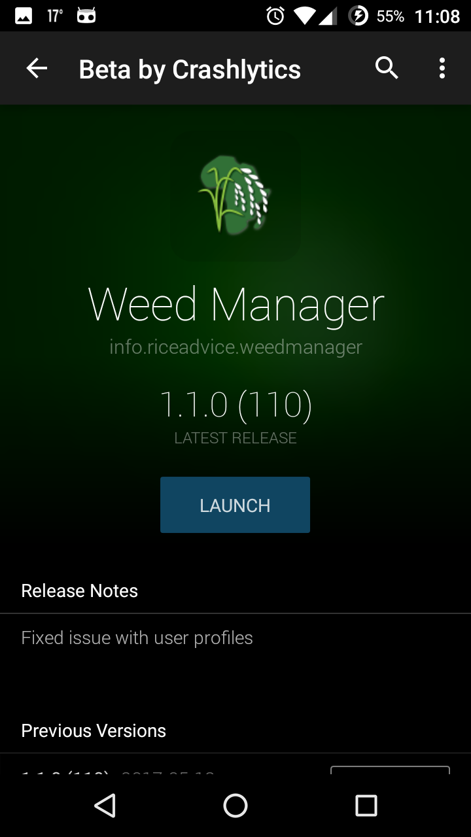
Stay connected to the internet
Click the DOWNLOAD button and wait for the download to be completed
Then click the INSTALL button
After installation is complete, click the LAUNCH button to fire up WeedManager

Slide 9
Open WeedManager
(for first use)

Slide 10
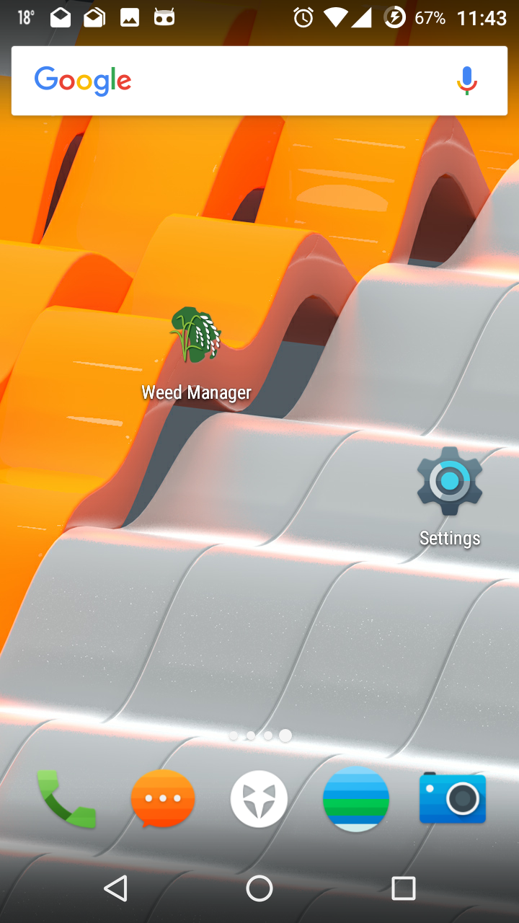
You can open WeedManager each time by clicking the icon on your device desktop

Slide 11
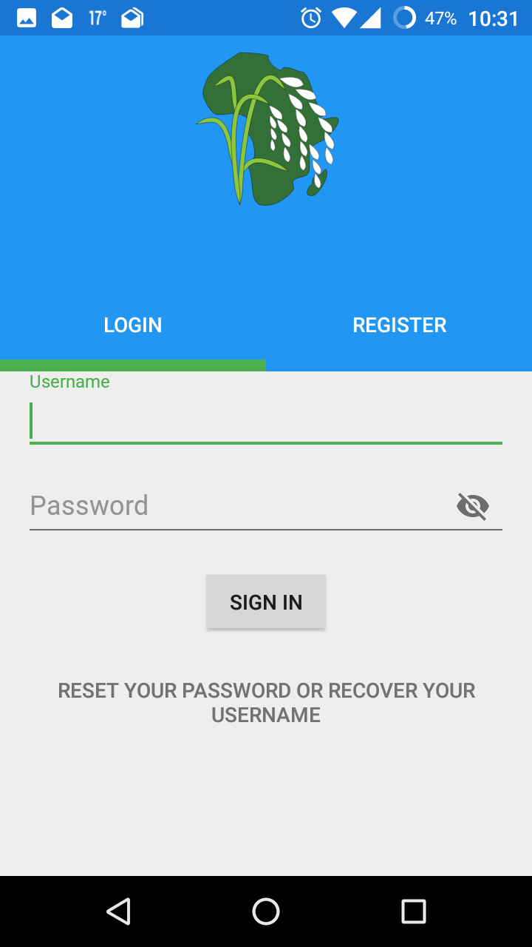
The first time you open WeedManager provide your Username and Password
Click the ‘SIGN IN’ button
Note: The functionality crossed out is not working yet.
XXXX
XXXXXXXXXXXXXXX

Slide 12
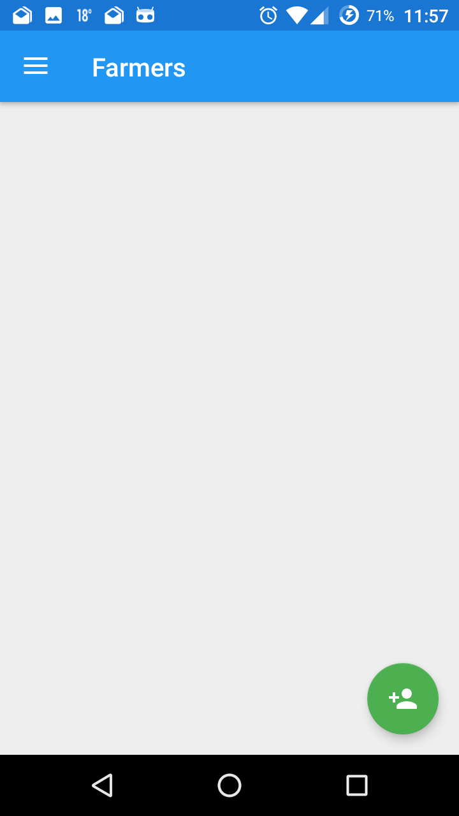
Once logged in you see a blank page called Farmers.
First complete your user profile. Click the menu in the upper left corner

Slide 13
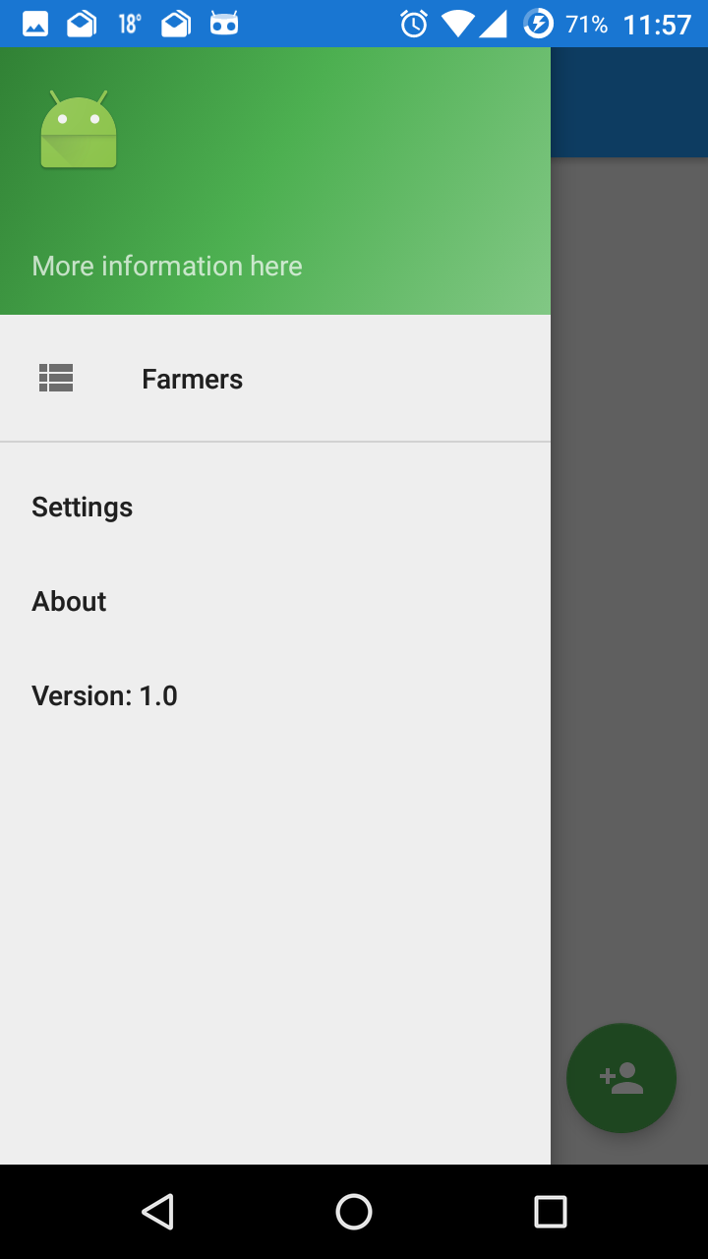
Then click the ‘pack-man’ icon to open your profile page.

Slide 14
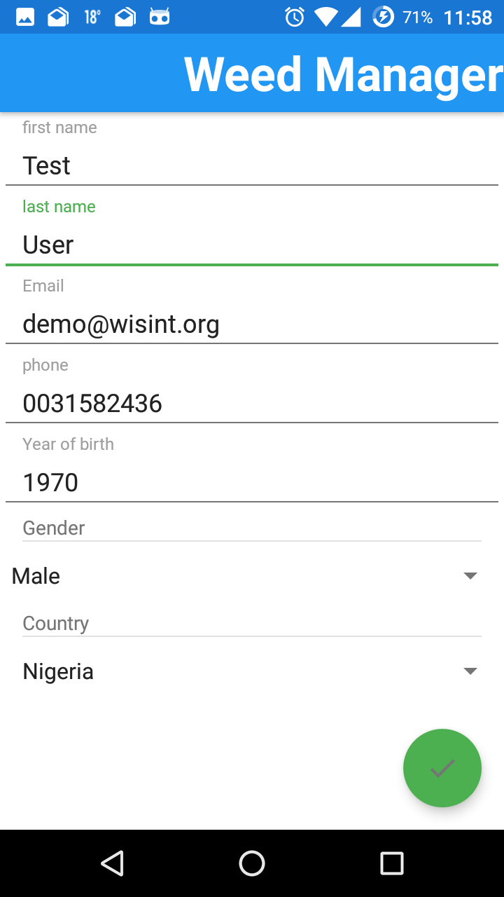
Now, complete your user account profile. Make sure you enter information in all fields.
Then click the green ‘done’ icon
After this, you can disconnect from internet. WeedManager does not require an active internet connection to operate.

Slide 15
Basic Navigation

Slide 16
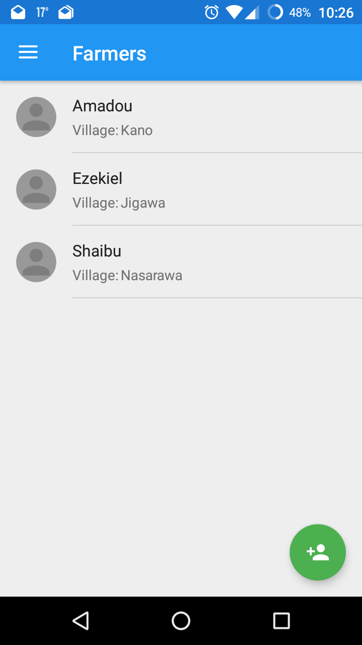
On the ‘Farmers’ page, click the green (+) icon in the lower right corner to add any farmer for who you want to create an advice.
All farmers you entered appear in the ‘Farmers’ list

Slide 17
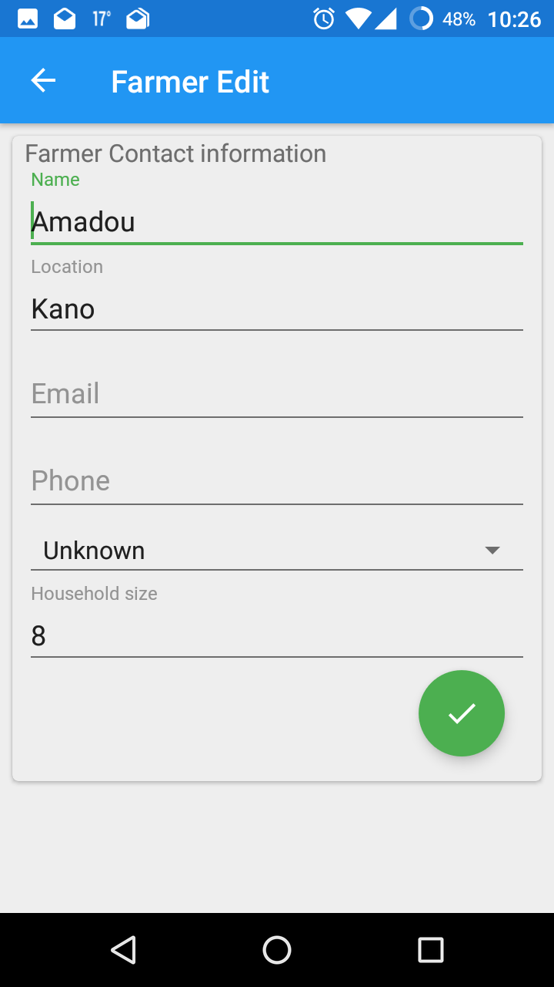
On the ‘Farmer Edit’ page, enter all information available for that farmer.
To save the farmer in your list, click the green ‘Done’ icon.

Slide 18
To see all current advices for a farmer, or to add a new advice for a farmer, click on the farmers’ name

Slide 19
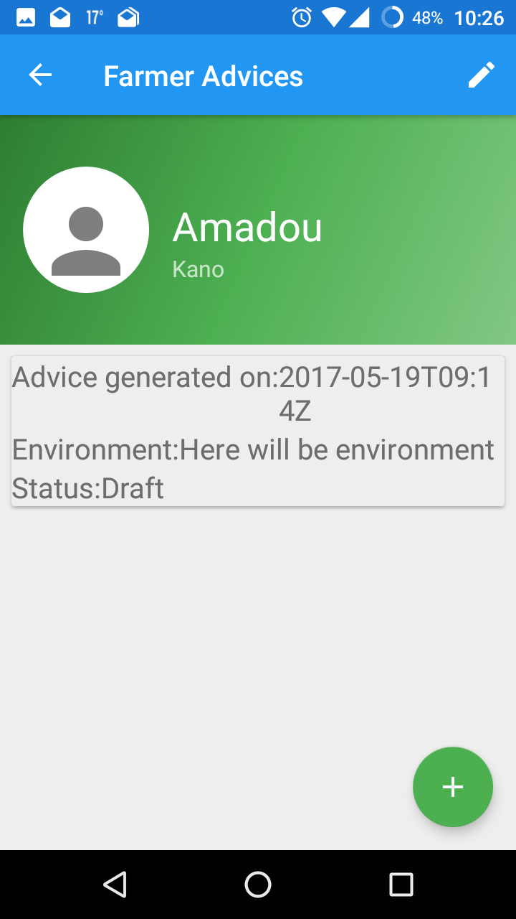
On this ‘Farmers Advices’ page, click the green (+) icon in the lower right corner to add an advice.
All advices for a specific farmer appear on this page, including their status.
Click on an advice in the list to see the advice details

Slide 20
Questions to generate an Advice

Slide 21
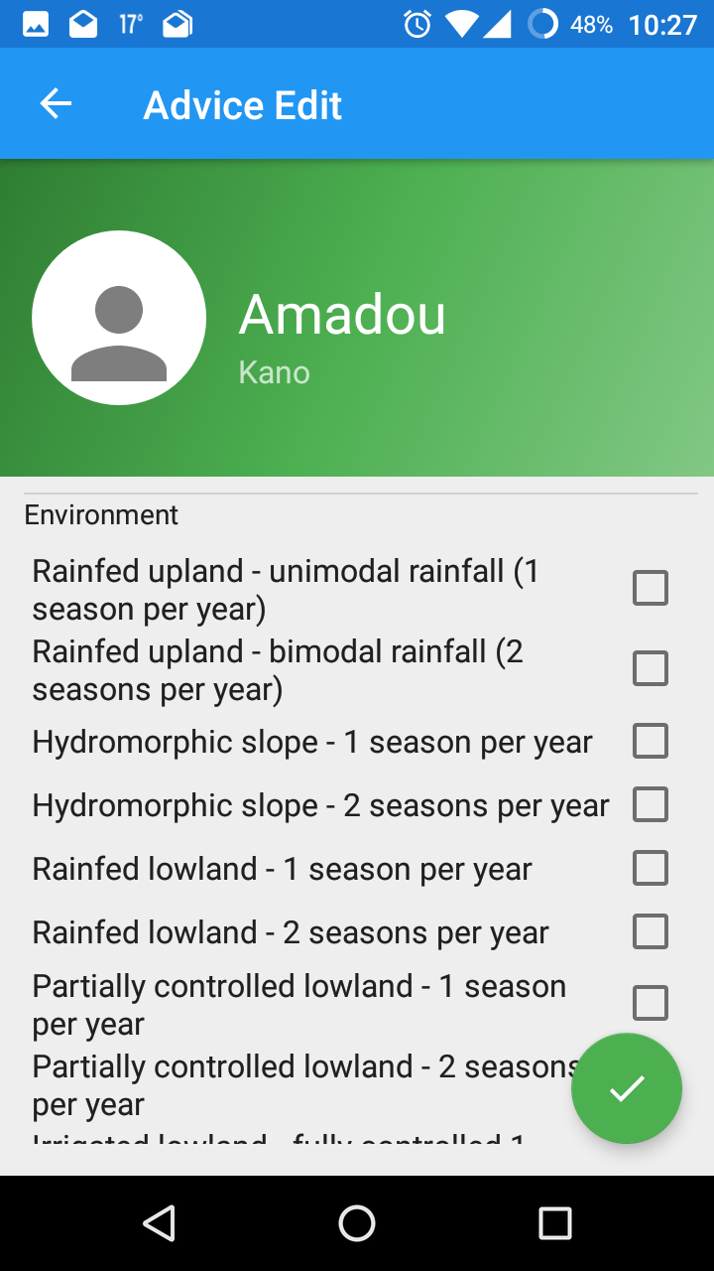
After clicking the ‘Add Advice’ icon (see previous section), you can provide the farm conditions, like environment, size, budget, equipment, etc.
Click the checkbox for each condition that apply to the farm

Slide 22
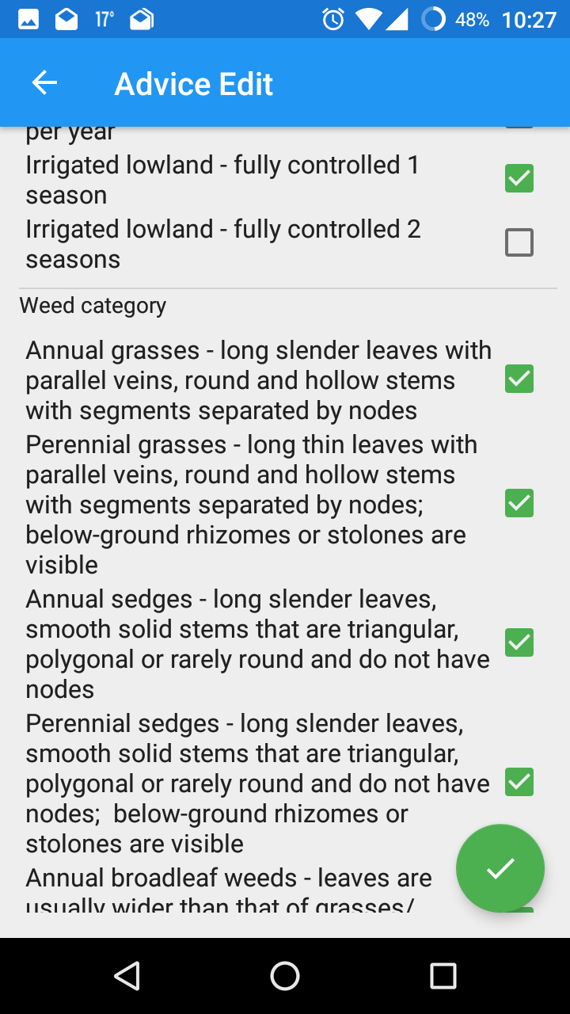
Scroll down to enter the Weed Categories the farmer is having problems with
Click the green ‘Done’ icon when finished to see the advice/ recommendations

Slide 23
Advice / Recommendations

Slide 24
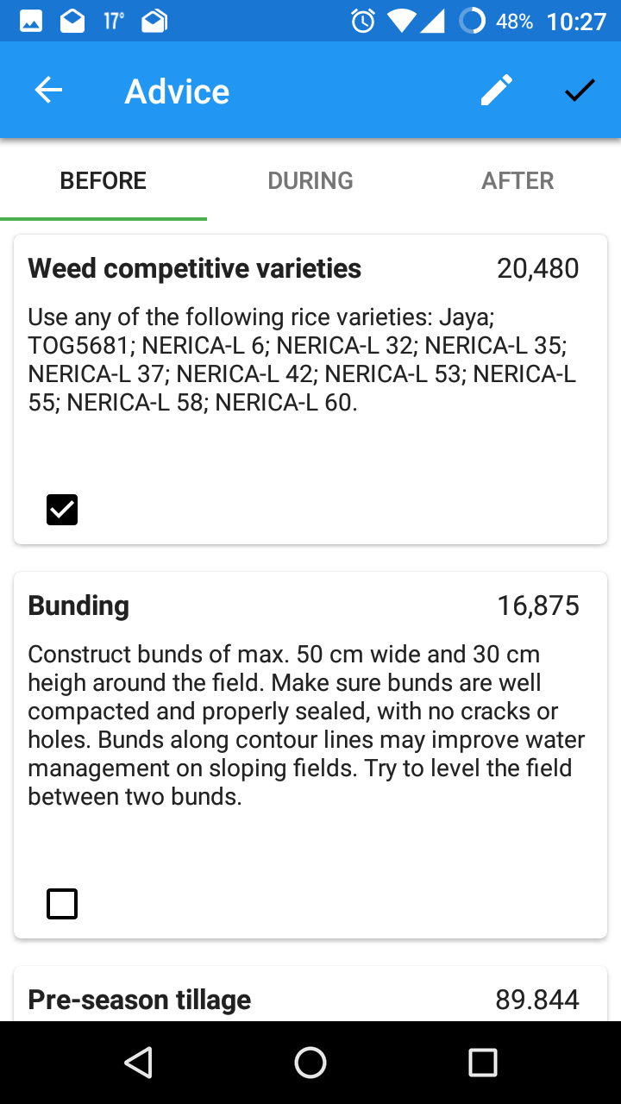
Any advice is split into 3 lists: before, during and after season recommendations
‘Swipe’ to navigate between the 3 lists
If you agree to follow a specific recommendation you can mark its check-box

Slide 25
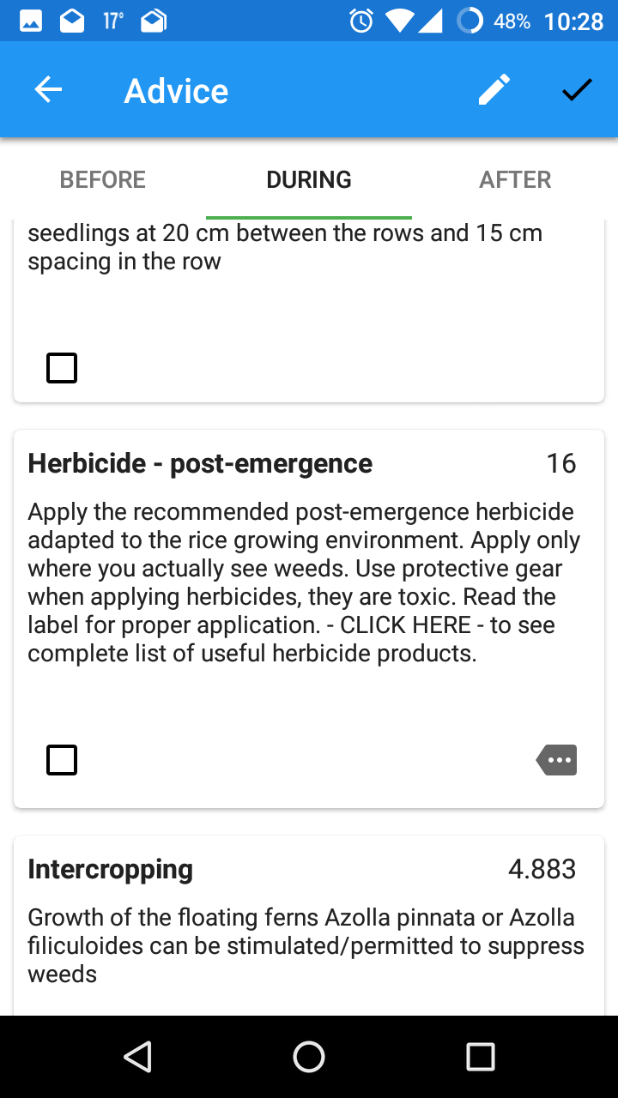
ALL recommendations that include herbicides show an additional icon
Click this icon to see the recommended herbicide list

Slide 26
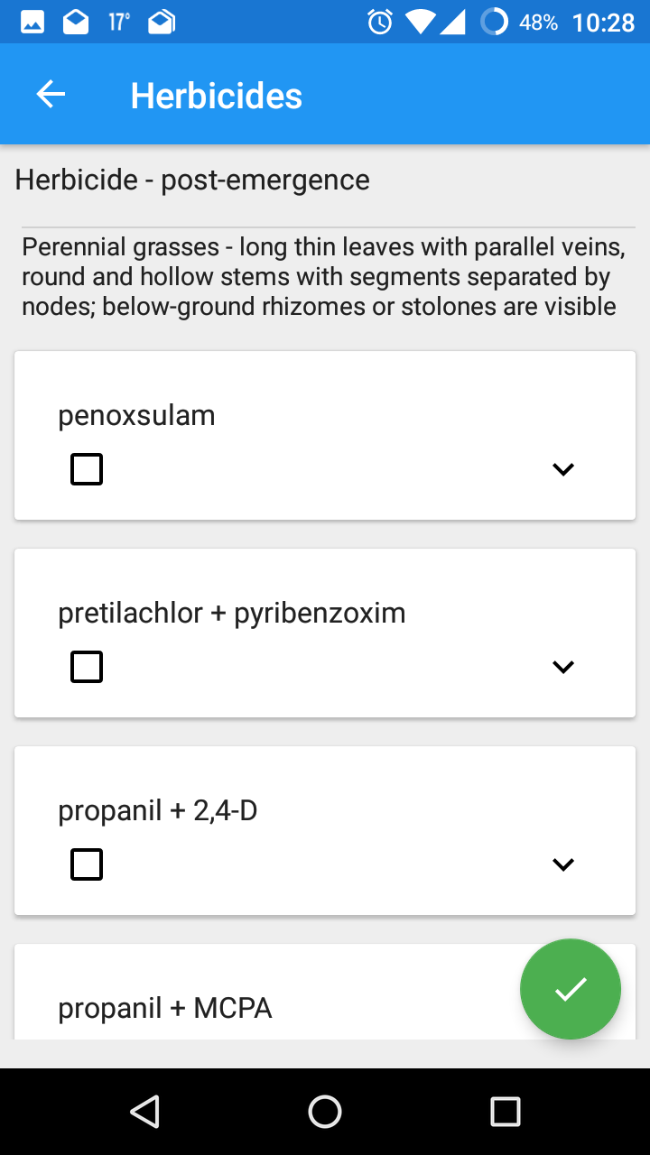
Recommended herbicides are listed per weed category
Click the ‘v’ on each herbicide card to see additional information for that specific herbicide

Slide 27
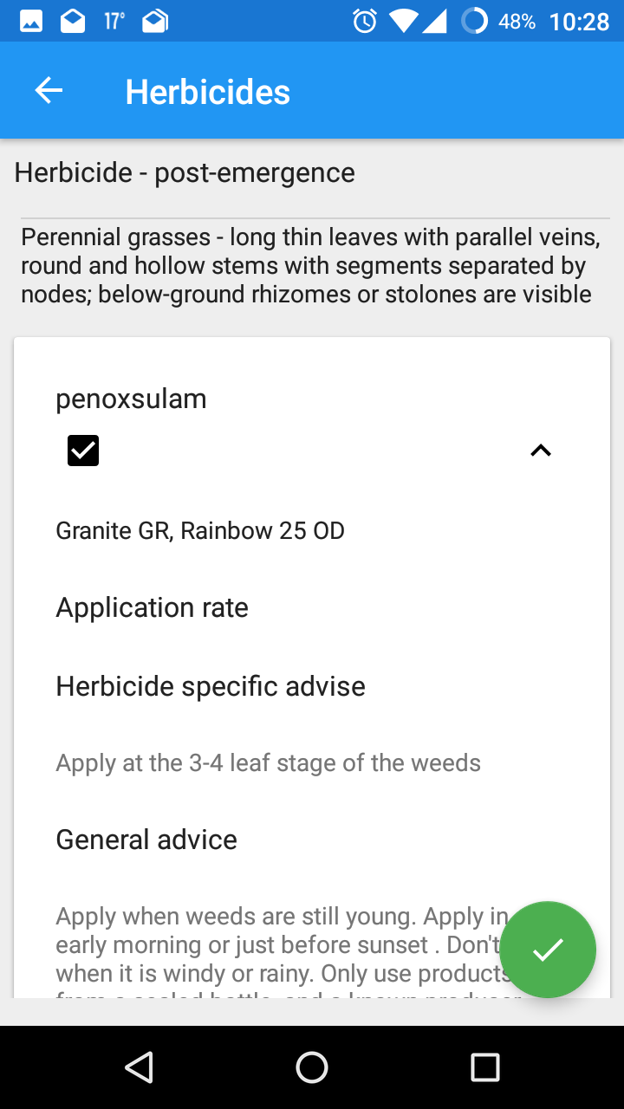
If you agree to apply a specific herbicide you can mark its check-box
Click the green ‘Done’ icon in the lower right corner when done with this page to return to the ‘before, during and after’ recommendations pages.

Slide 28
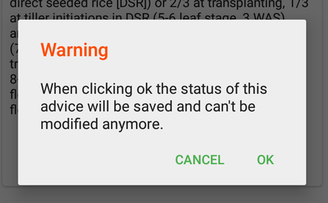
If you are done with selecting all recommendations you want to implement, click the ‘v’ icon in the upper right corner to save the status of the advice
Click ‘OK’ in the pop-up window if you are sure.

Slide 29
Sending your Data

Slide 30
When you are back in the office and have internet connection, data entered in the field can be synchronized to the central server. Open WeedManager when connected to the internet to force synchronization.
Make sure you regularly connect to the internet to save your data to the server.

Slide 31
Troubleshooting

Slide 32
Support levels
Your first option to solve any questions you have is to consult the various support materials provided to you like (training) manuals, guidelines, videos, etc.
Your second option is to consult with your WeedManager Focal Point / Trainer, being someone from AfricaRice or CARI
If you have any weed management questions you were unable to solve using the suggestions in step 1 or 2, you may write an email to j.rodenburg@cigar.org
If you encounter any technical issues e.g. WeedManager stops working, you may write an email to Joost Lieshout at support@riceadvice.info

