Slide 1

RiceAdvice-WeedManager
Weed Management Advices
Technical Clarifications

Slide 2
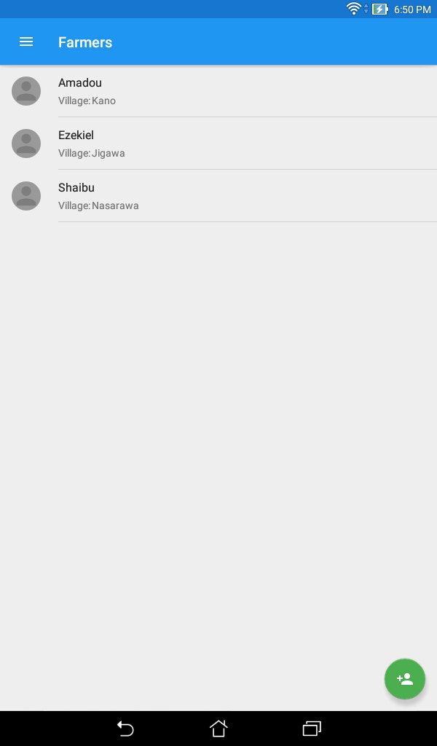
Each Service Provider (SP) will have a number of farmers in his/her account; here:
Amadou
Ezekiel
Shaibu

Slide 3
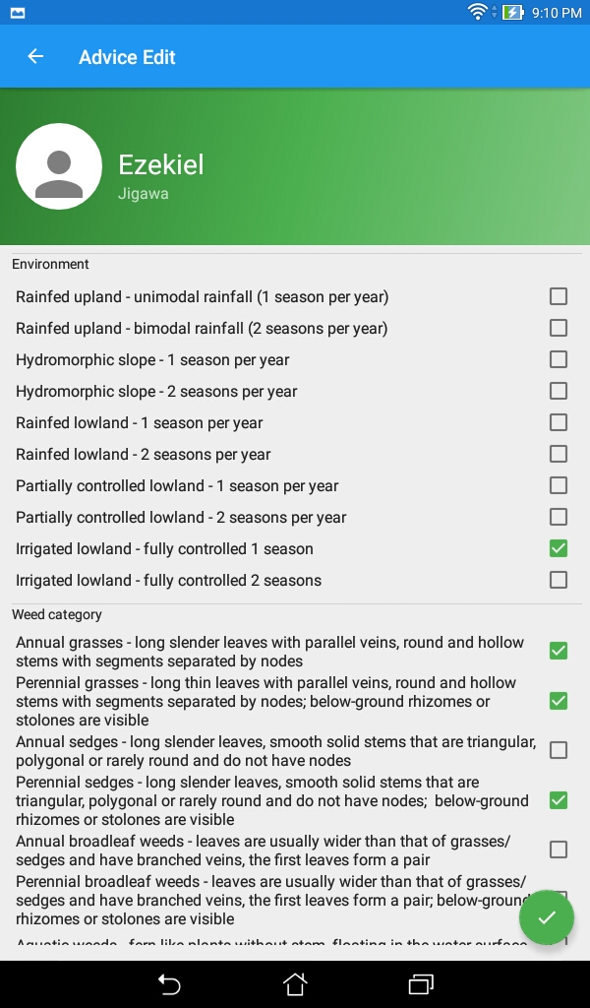
Each farmer’s field is in a specific environment (upland – rainfed lowland – irrigated lowland)
With field-specific weed problems (annual or perennial grasses – sedges – broadleaved species; aquatic or parasitic weeds ); for help in identifying the categories: see Video 1

Slide 4
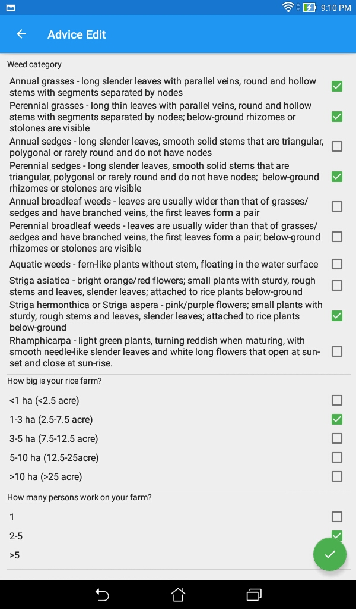
Indicate approaximate area of the rice field for which the recommendation is to be made ...

Slide 5
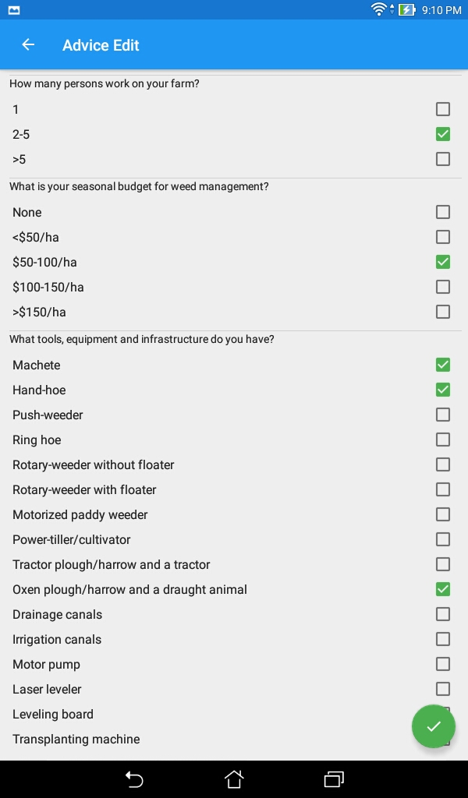
Indicate the number of laborers that can work on the farm
Indicate the farm size …
Indicate the available or potentially accessible equipments ...

Slide 6
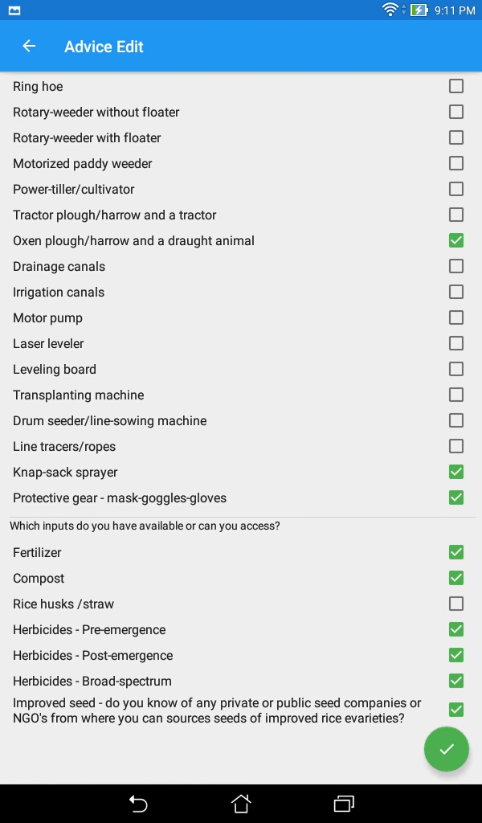
For each farmer: indicate which equipment and inputs are available
Note-1: to generate a recommendations one can indicate the potential equipment/inputs, even if some still need to be purchased
Note-3: Only if the ‘Knap-sack sprayer’ and ‘Protective gear’ are ticked, herbicides may turn up in the recommendation
Note-2: if uncertain about the type of herbicides available (either at the farm or at the local market), tick all three types
Click this at the end to generate the full recommendation

Slide 7
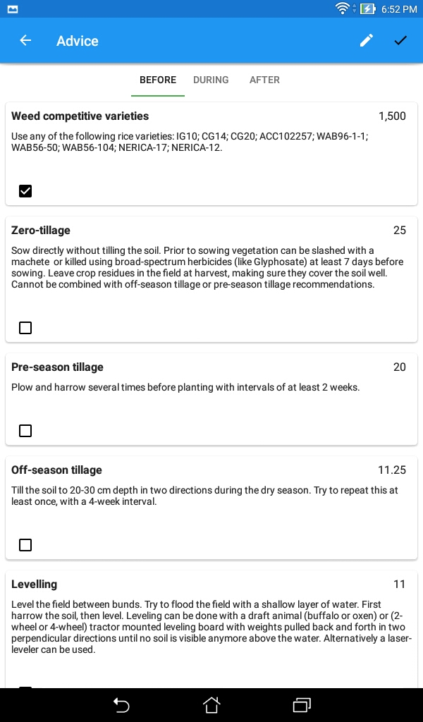
SPs discuss which each farmer to select the advices that he/she can actually carry out BEFORE the season ...
For instance, if the weed competitive varieties in this list are available, the farmer can opt for this ...
If the farmer has no inputs (e.g. Glyphosate) or equipment (e.g. Oxen plow) to carry out some advices, they can be left unticked

Slide 8
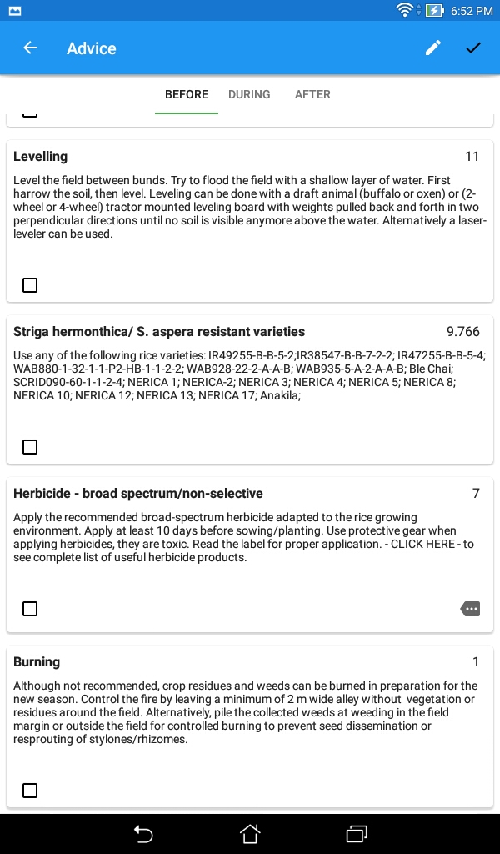
Leave less relevant advices unticked …
If proposed varieties are not locally available …
Or if the proposed herbicide option is not available or too expensive...
Burning is not recommended, but could be used if other options are all not feasible

Slide 9
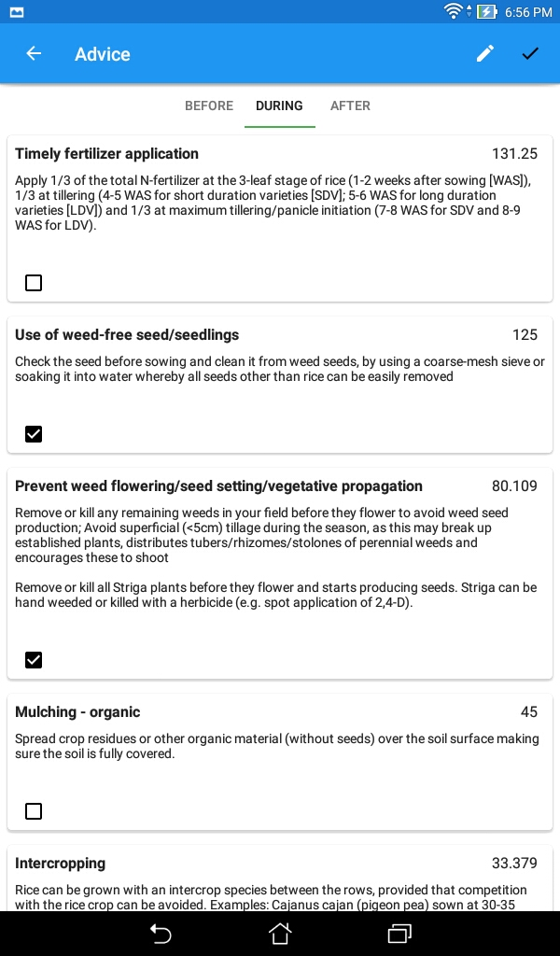
SPs discuss which each farmer to select the advices that he/she can actually carry out DURING the season ...
For instance, using rice seed that is clean and free of weed seeds ...
And preventing weeds from flowering and seed production by timely removal…
But, for instance, if there’s no organic matter for mulching, this advice can be ignored ...

Slide 10
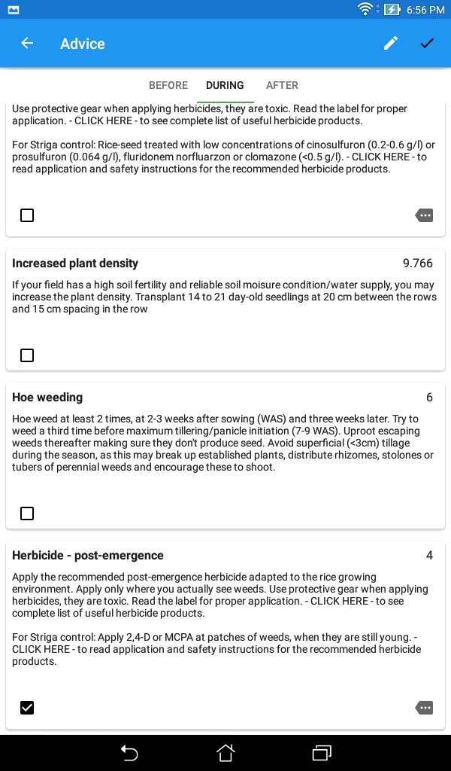
If the farmer can access a certain type of herbicdes, like post-emergence herbicides, you can click here to select the exact product ...

Slide 11
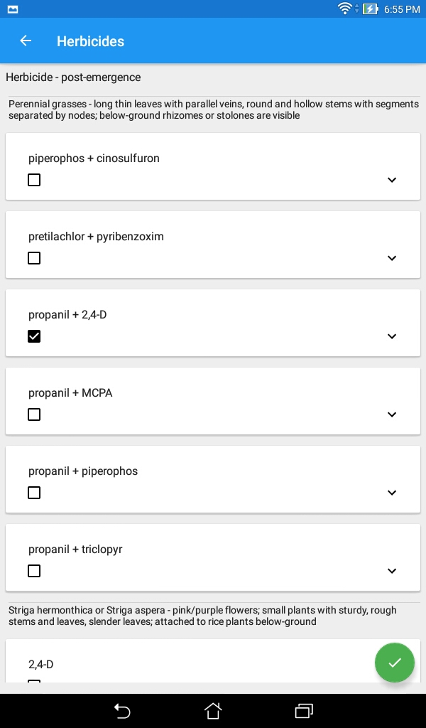
The best choice is a herbicide that is available on the local market, and that targets the different types of weeds encountered in the field ... In this case: Propanil + 2,4-D ... Effective against perennial grasses ...

Slide 12
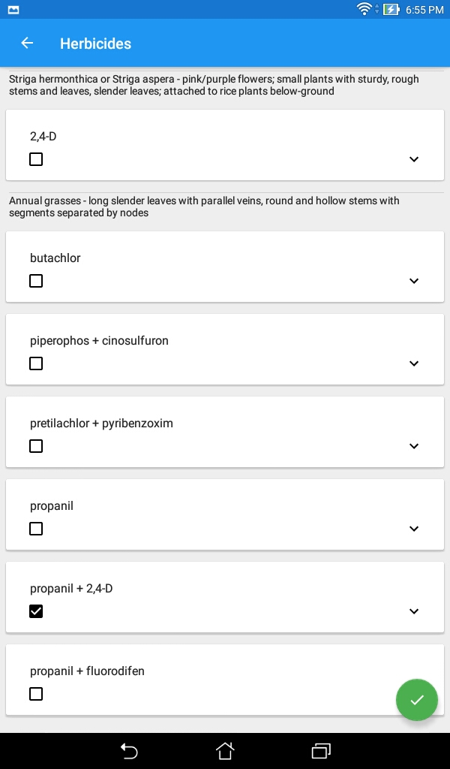
… against Striga hermonthica ...

Slide 13
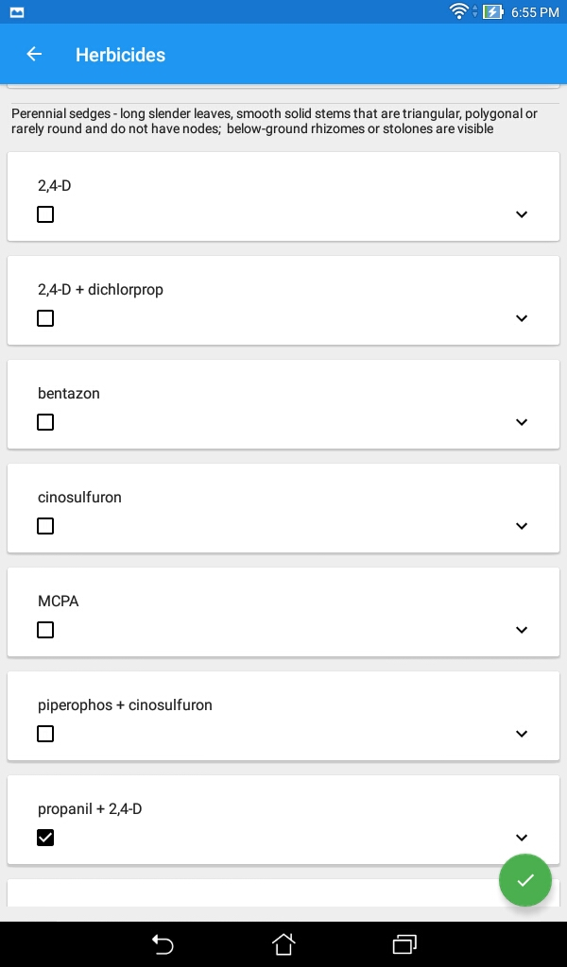
… and, against perennial sedges !
For details on the commercial name of products, application rates and specific and general advices, you click on the down-ward pointing arrow ...

Slide 14
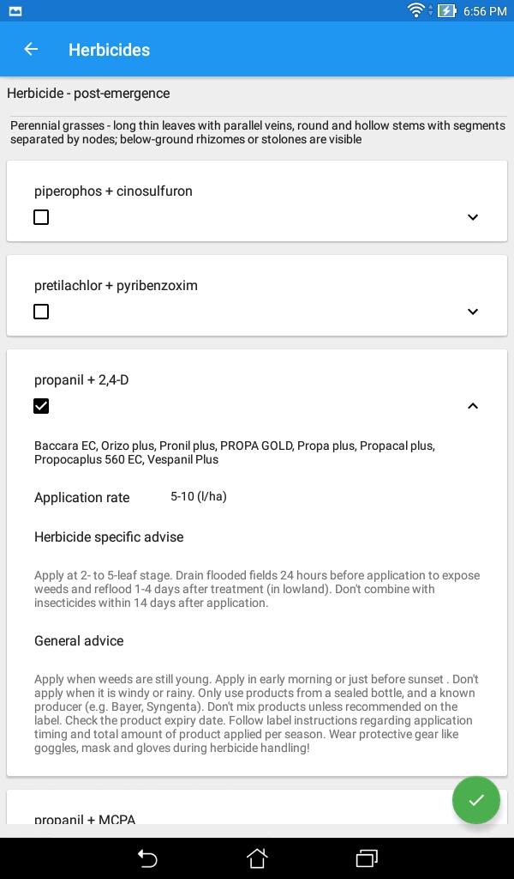
.... for a drop-down card with information ...

Slide 15
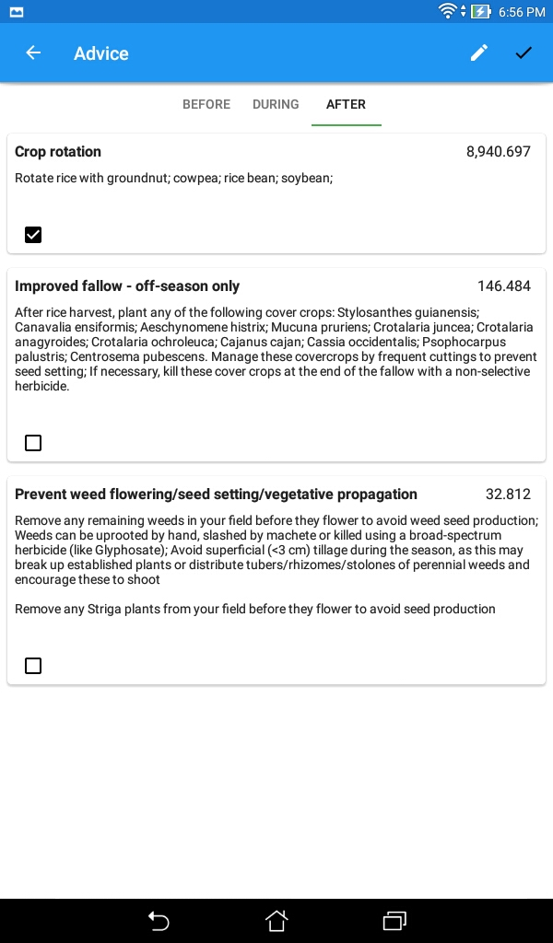
Crop rotation can be a good option AFTER the rice season ... if it fits the farming system
Improved fallow may be practiced but this may be economically less attractive

Slide 16
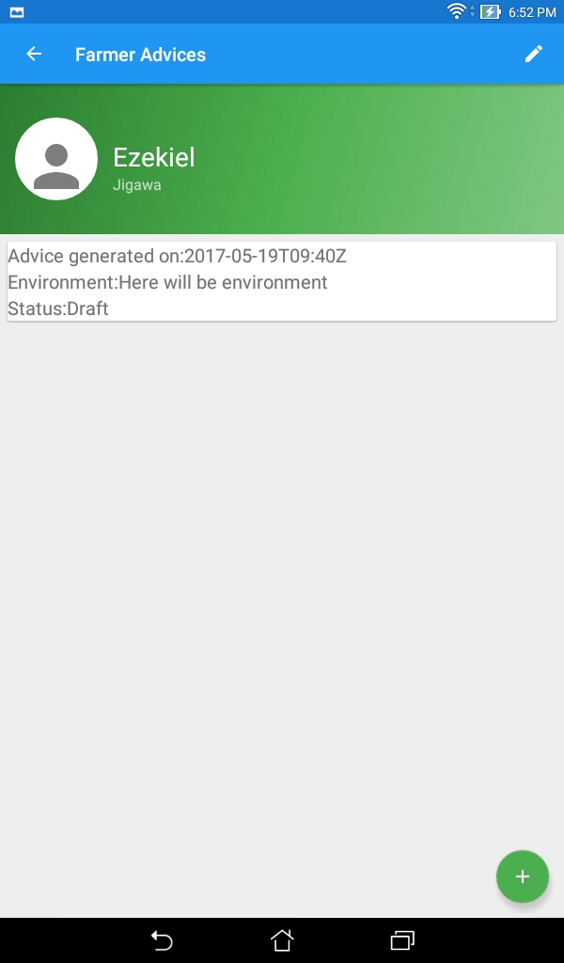
Once saved, the advice can be accessed by clicking here ...
If necessary, another advice can be generated for this farmer, either for another field or to have an alternative scenario for the same field, by clicking here ...

Slide 17
Implementation
Service providers (SPs) should check availability of herbicides and seed of varieties on local markets to be able to inform the farmer during discussions on the recommendations to follow
SPs should explain advantages/disadvantages of inputs and equipment available on local markets
SPs should meet with farmers regularly to follow up on advices, BEFORE – DURING – AFTER season
The farmers should be stimulated to make a planning indicating dates of each task

