Slide 1
Protocol for on-farm testing trial for RiceAdvice-WeedManager

Slide 2
Objectives
To evaluate the use of WeedManager —user friendliness, relevance of advices
Evaluate results of followed-up WeedManager recommendations —relative to results of farmers’ own weed management practices.

Slide 3
Approach & Agreements (1)
Each service provider (SP)* selects 10 farmers
Farmers should not be too remote; the selection of 10 farmers represents diversity in terms of
  Environment, Financial situation, Gender, Farm size
Each selected farmer agrees that …
  Half of his/her field will be ‘experimental’ and on the other half he/she will follow the same management as in the previous year
  The total farmer’s field will have a minimum size of 1 acre (≈4,000 m²).
  The SP will remind the farmer of different activities to undertake and provide technical guidance but will not provide financial assistance
* SP could also mean extension agent or CARI technician

Slide 4
Approach & Agreements (2)
Each selected farmer agrees that …
  Farmers SPs to periodically monitor the field evaluation and record information
  Farmers allow a field day and field visits for neighboring farmers
  Farmers allow the CARI technicians to harvest and thresh the paddy from a 5 × 5 m observation area in both halves of his/her field
The SP interviews each selected farmer to obtain necessary base-line information on ‘farmer practice’ and yields of the past year (Form 1)

Slide 5
Approach & Agreements (3)
The SP will make a profile for each farmer and generate 1-3 recommendations for each farmer.
Recommendations will be discussed with the farmer and based on willingness/ capacity 1 recommendation will be chosen and followed-up during the year.
Within the recommendation advices to follow will be selected and fixed
The SP will save the recommendation and makes sure advices are being implemented in time by the farmer
The SP follows up with each farmer on actual equipment and inputs used during the year (inc. costs and time spent on weed management) for both the ‘farmer practice’ and the ‘WeedManager’ half of the field

Slide 6
Implementing field evaluation & data collection (1)
Separate farmer’s field in 2 halves by a bund. One half will be ‘farmer practice’ and the other follows ‘WeedManager’ recommendations.
In each half mark out 5 × 5 m yield assessment and weed observation areas in the middle of the plot
The 25 m² observation areas will be used for weed observations and crop performance at mid-season and at harvest
Other observations, like time and other inputs, will be done over the whole plot (Form 1)

Slide 7
Implementing field evaluation & data collection (2)
Record the actual date and modalities of interventions and inputs in each plot in Form 2.
Record paddy yield for each plot in Form 3:
  At crop maturity, harvest all plants in the middle 25 m² (5 × 5 m) harvest area of each of the two treatment plots
  Thresh and clean the grain. Place all grain into bags labeled for each treatment
  Weigh each bag to determine total grain weight for each sample
  Measure grain moisture content using a moisture meter for each treatment (from AfricaRice).

Slide 8
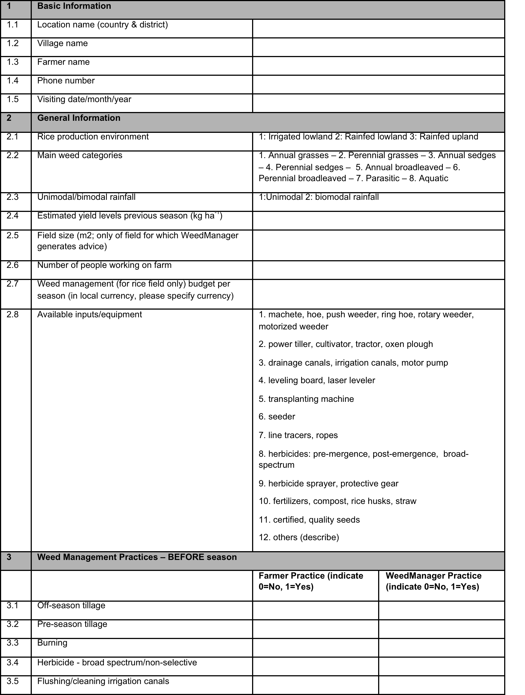
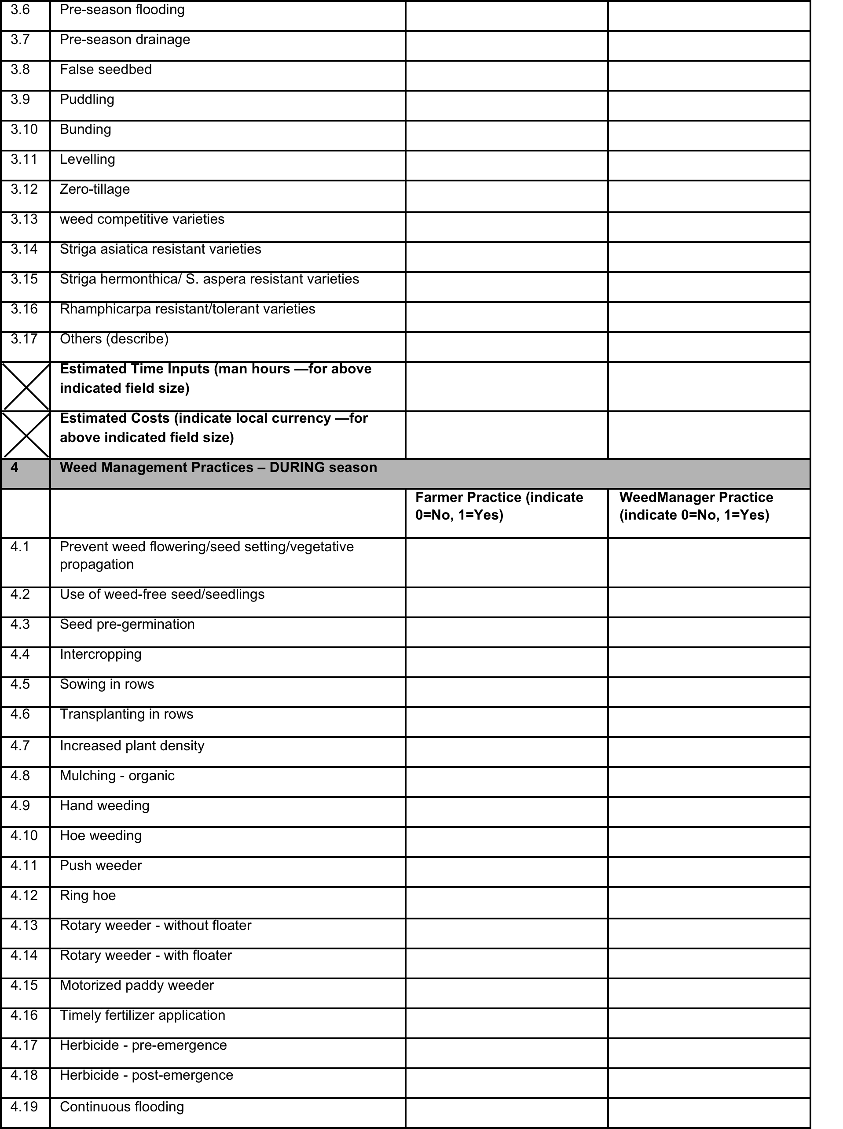
Form 1– Actual weed management practice (1)

Slide 9
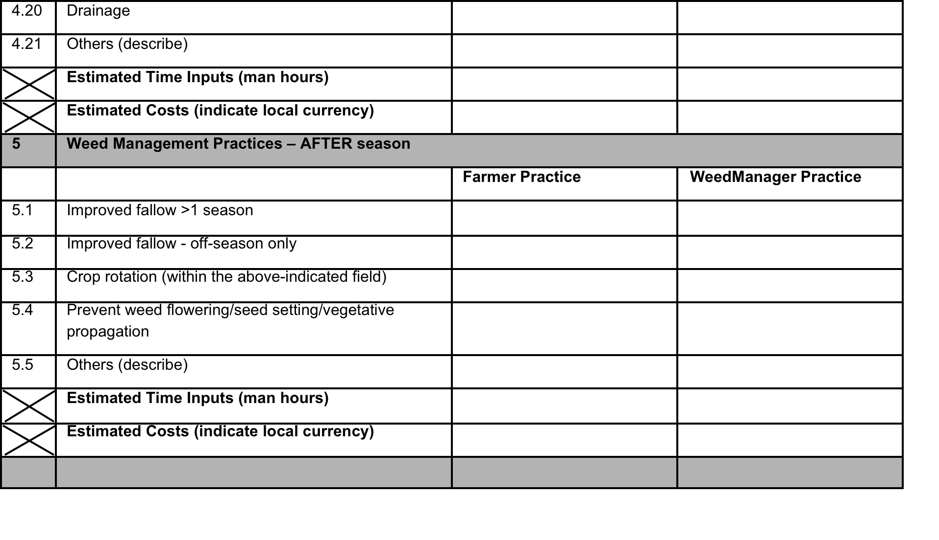
Form 1– Actual weed management practices
(2)

Slide 10
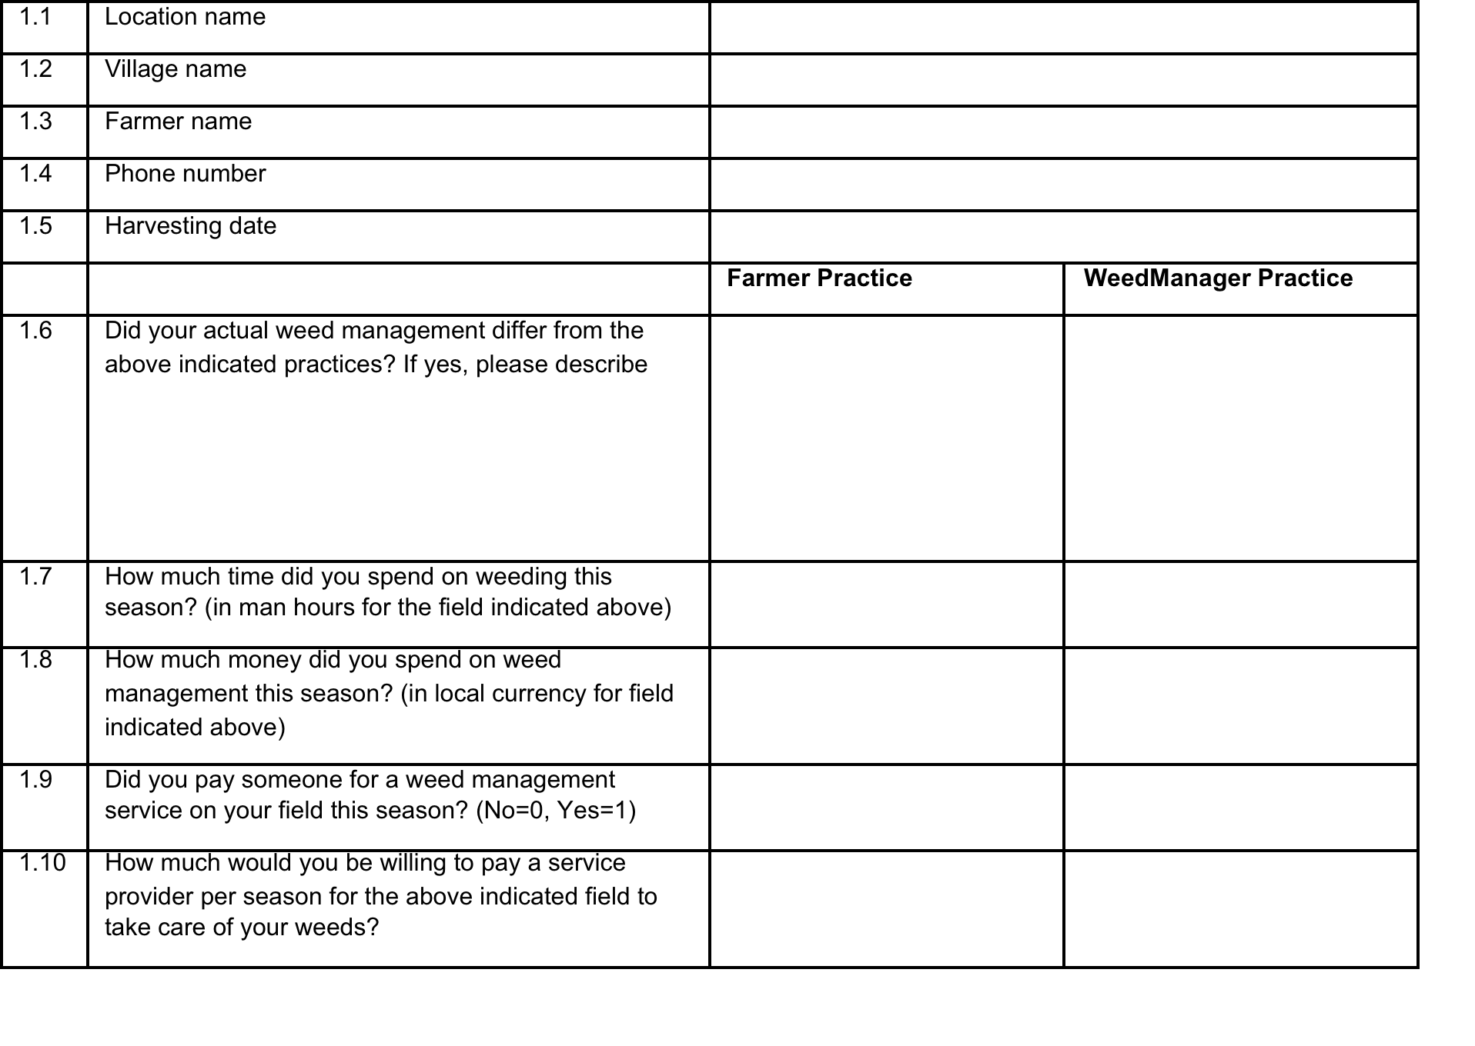
Form 2 – Data collection at harvest (1)

Slide 11
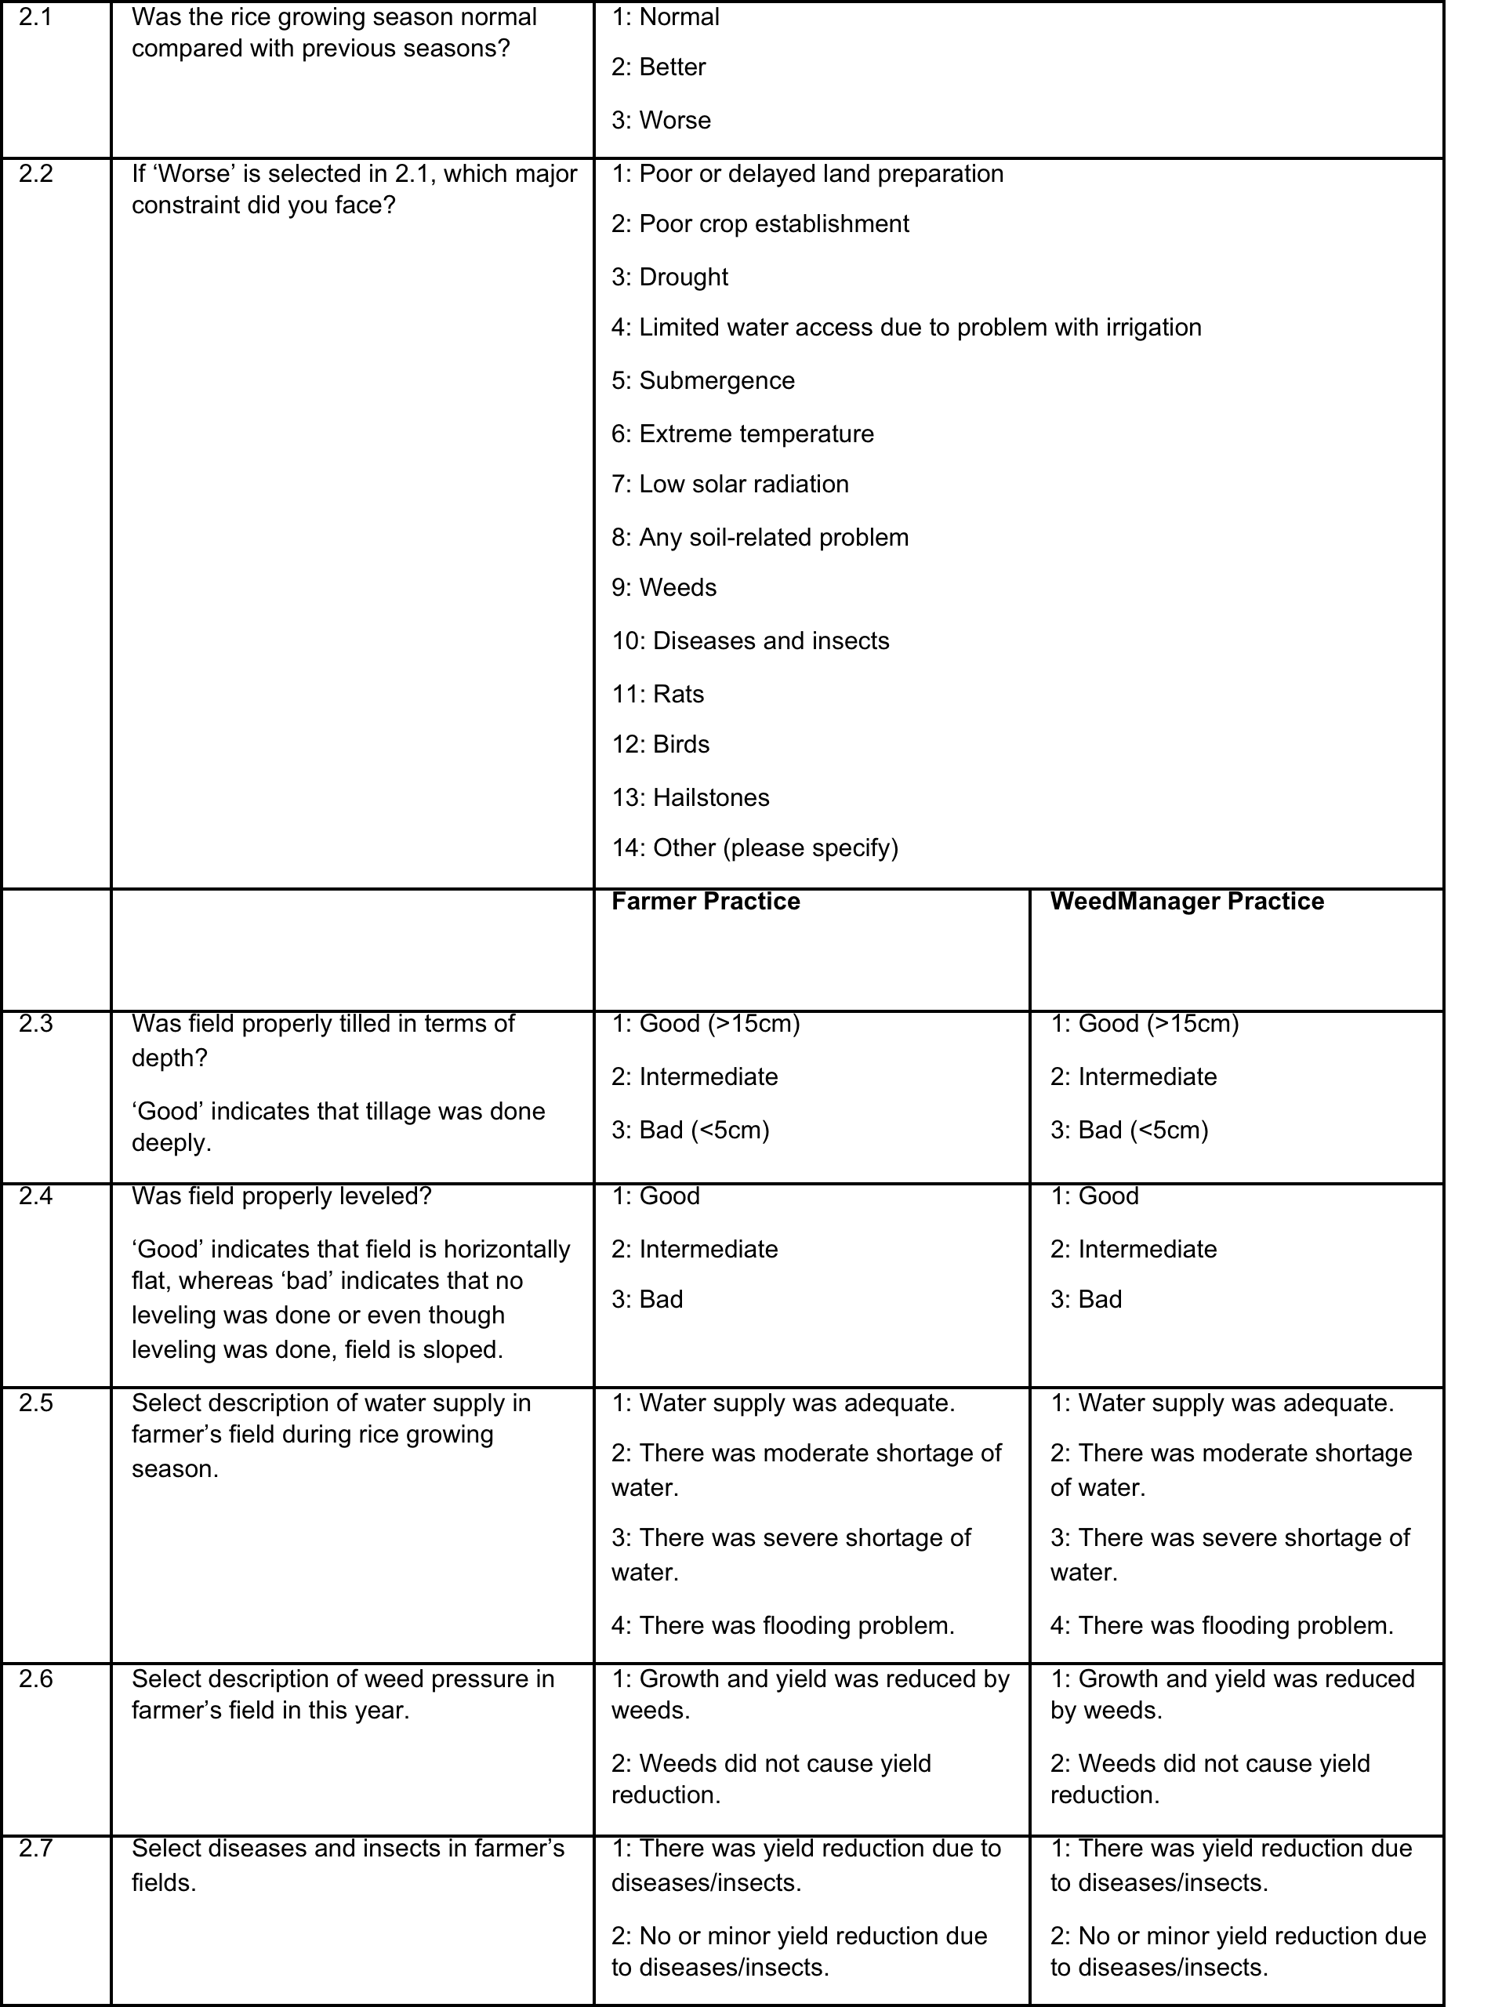
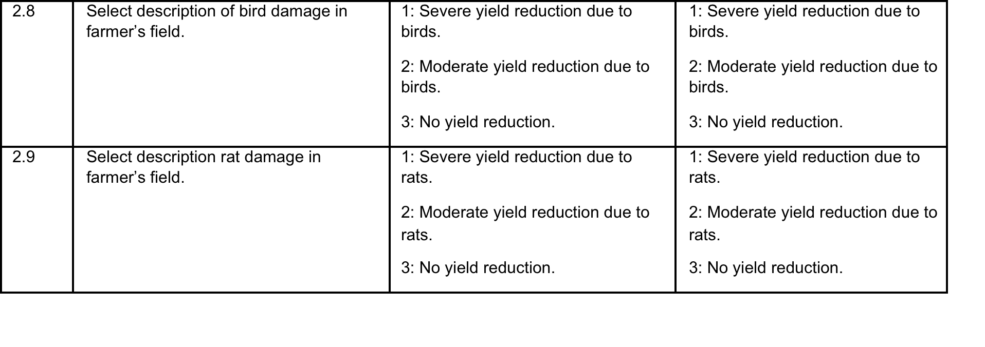
Form 2 – Data collection at harvest (2)
Complete the following form through interview of each farmer

Slide 12
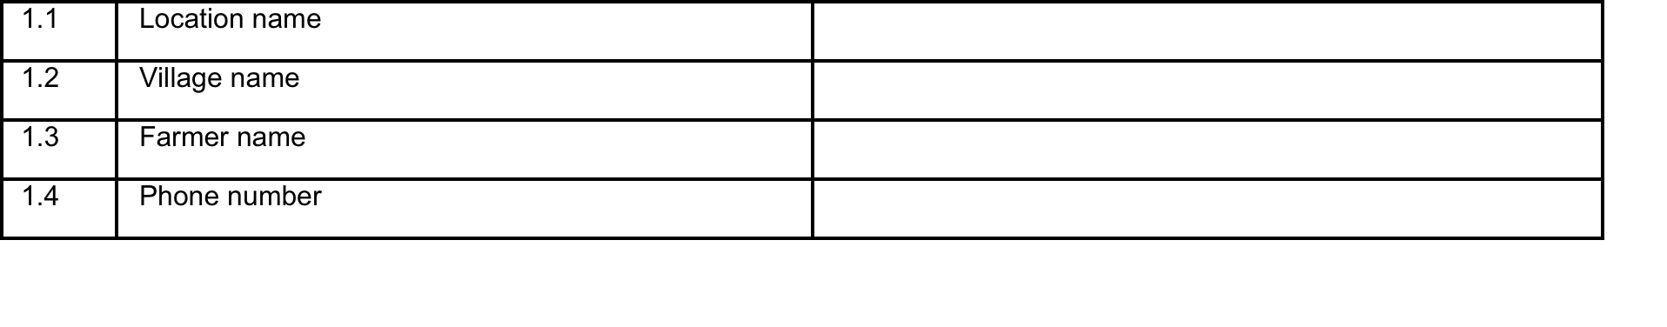
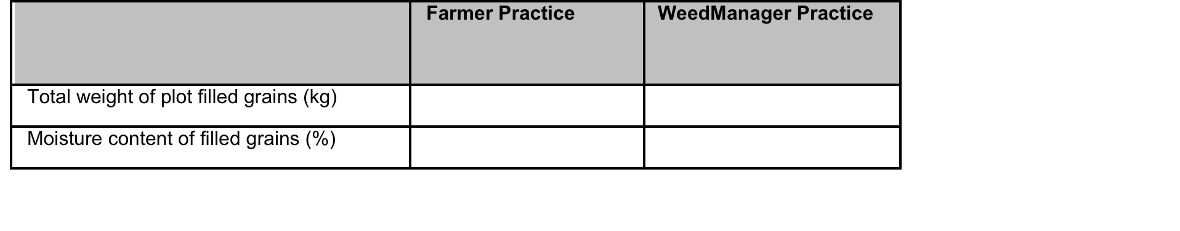
Form 3 – Yield assessment

Slide 13
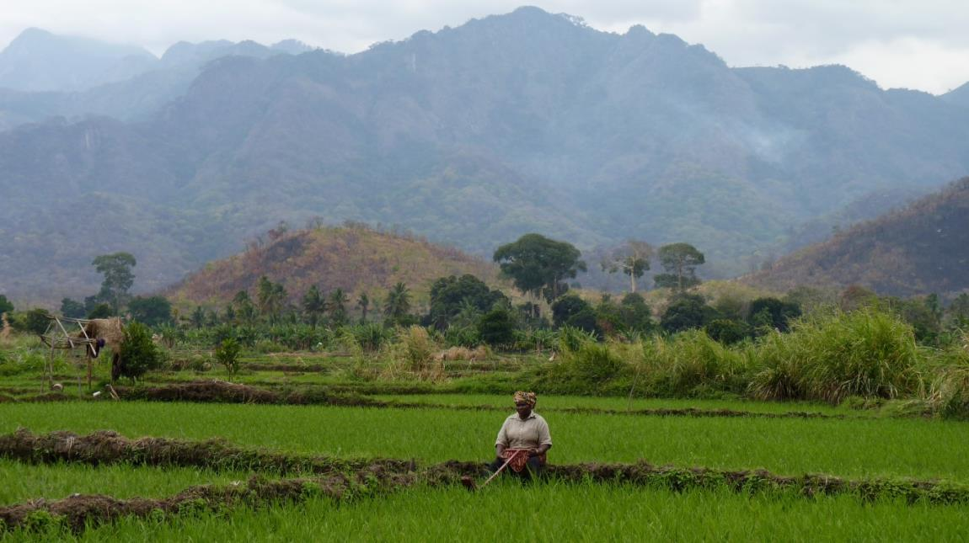
Thank you for your attention

